Slide 1
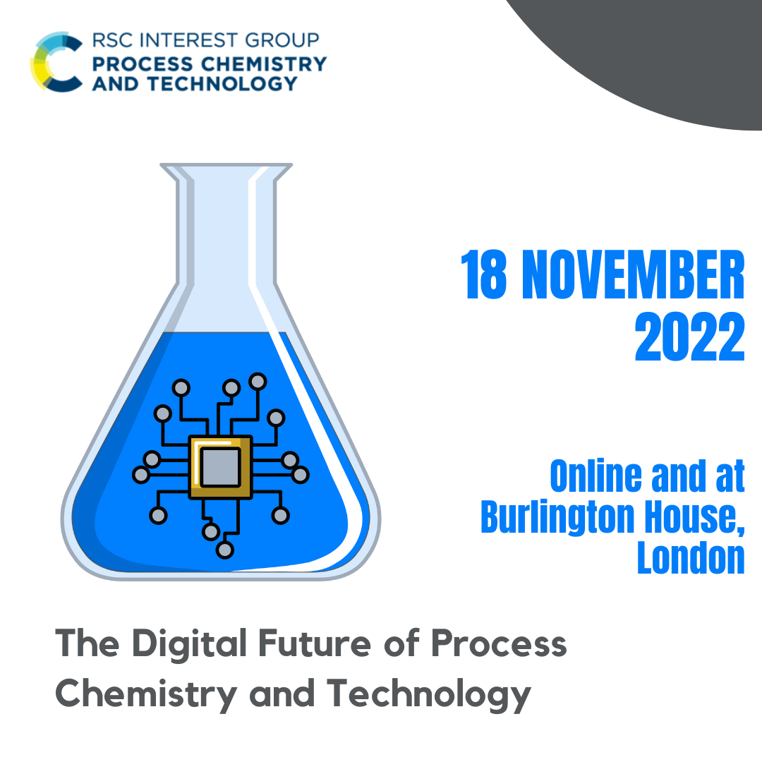
Welcome

Slide 2
Sponsored by

Slide 3
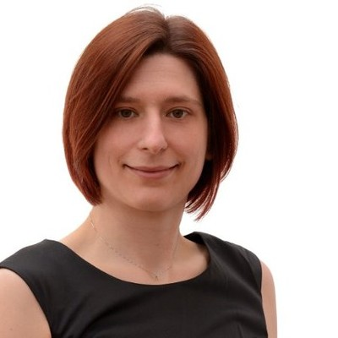
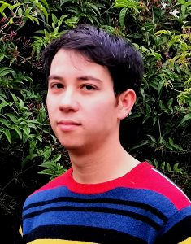
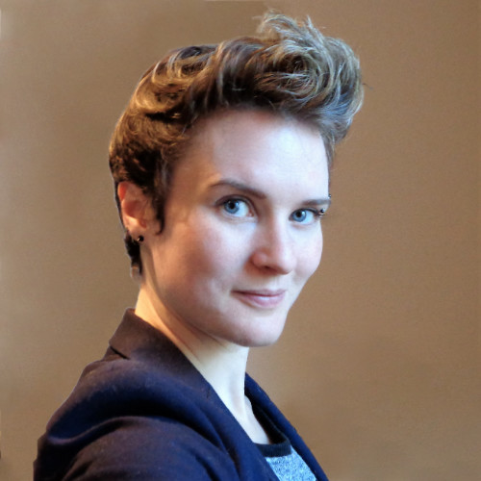
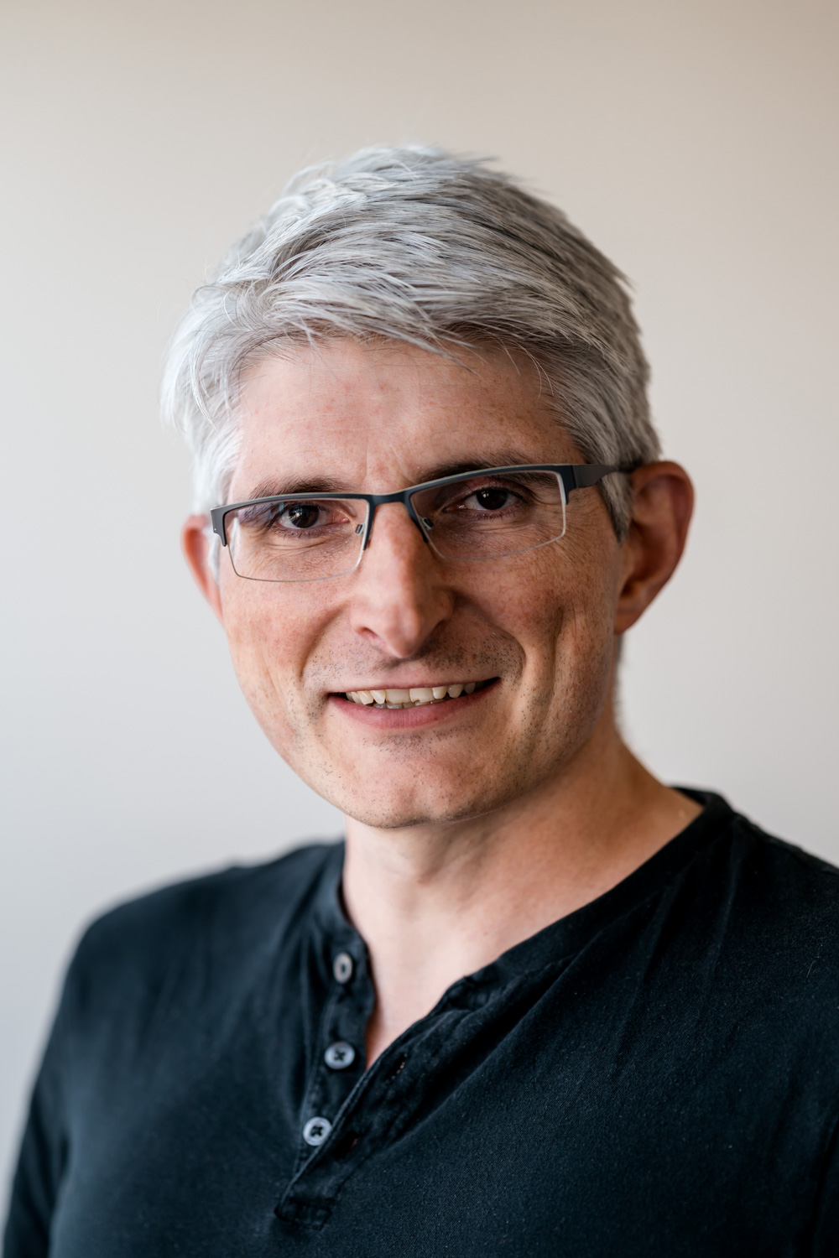
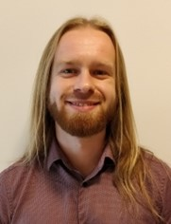
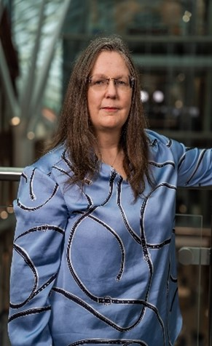
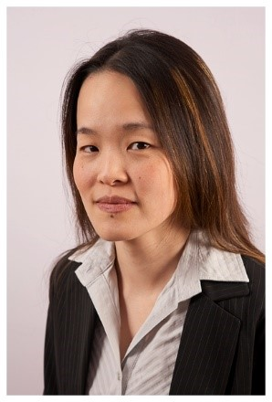
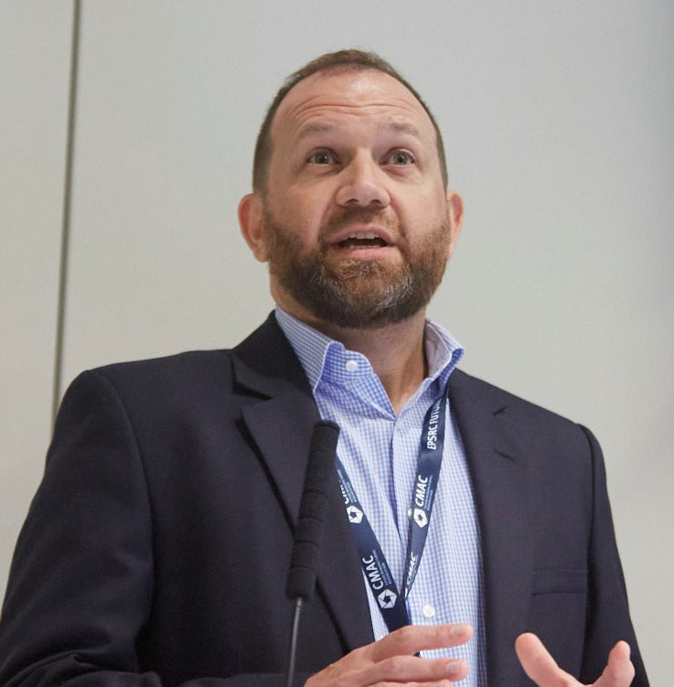
Your Speakers Today

Slide 4
0900 | Registration
1000 | Introductions | Process Chemistry and Technology Group
1005 | King Kuok (Mimi) Hii | ROAR, Imperial College London
1035 | Nicholas Jose | Cambridge University
1100 | Stuart Little | JMP Statistical Discovery
1110 | Jon-Paul Sherlock | AstraZeneca
1135 | Jason Williams | Research Center Pharmaceutical Engineering GmbH
1200 | Panel Discussion | Speakers from the morning session and Andrea Sauerwein, Johnson Matthey
1230 | Networking Lunch
1400 | Andy Maloney | The Cambridge Crystallographic Data Centre
1430 | Joan Cordiner | The University of Sheffield
1500 | Nessa Carson | AstraZeneca
1530 | Panel Discussion | Speakers from the afternoon session and Markus Gershater, Synthace
1600 | Close for online | Drinks Reception
1730 | Close

Slide 5
0900 | Registration
1000 | Introductions | Process Chemistry and Technology Group
1005 | King Kuok (Mimi) Hii | ROAR, Imperial College London
1035 | Nicholas Jose | Cambridge University
1100 | Stuart Little | JMP Statistical Discovery
1110 | Jon-Paul Sherlock | AstraZeneca
1135 | Jason Williams | Research Center Pharmaceutical Engineering GmbH
1200 | Panel Discussion | Speakers from the morning session and Andrea Sauerwein, Johnson Matthey
1230 | Networking Lunch
1400 | Andy Maloney | The Cambridge Crystallographic Data Centre
1430 | Joan Cordiner | The University of Sheffield
1500 | Nessa Carson | AstraZeneca
1530 | Panel Discussion | Speakers from the afternoon session and Markus Gershater, Synthace
1600 | Close for online | Drinks Reception
1730 | Close
Download full programme here

Slide 6
Full delegate list in programme

Slide 7
Register for upcoming webinars

Slide 8
0900 | Registration
1000 | Introductions | Process Chemistry and Technology Group
1005 | King Kuok (Mimi) Hii | ROAR, Imperial College London
1035 | Nicholas Jose | Cambridge University
1100 | Stuart Little | JMP Statistical Discovery
1110 | Jon-Paul Sherlock | AstraZeneca
1135 | Jason Williams | Research Center Pharmaceutical Engineering GmbH
1200 | Panel Discussion | Speakers from the morning session and Andrea Sauerwein, Johnson Matthey
1230 | Networking Lunch
1400 | Andy Maloney | The Cambridge Crystallographic Data Centre
1430 | Joan Cordiner | The University of Sheffield
1500 | Nessa Carson | AstraZeneca
1530 | Panel Discussion | Speakers from the afternoon session and Markus Gershater, Synthace
1600 | Close for online | Drinks Reception
1730 | Close

