Slide 1
Late stage ideas from early development
How structural informatics approaches can transform pharmaceutical processes
Andy Maloney
Particle Science Team Leader
18th November 2022

Slide 2
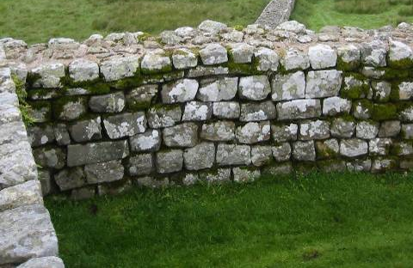
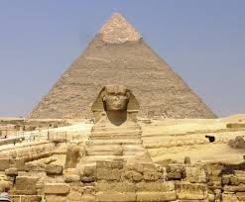
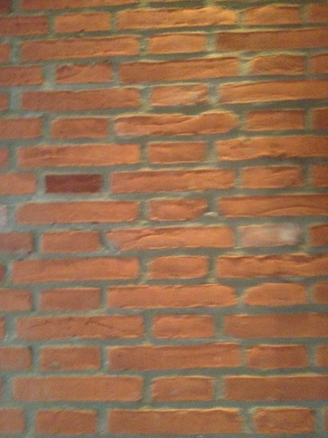
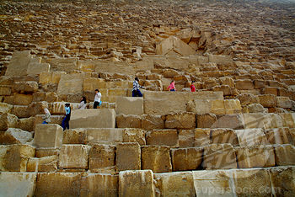
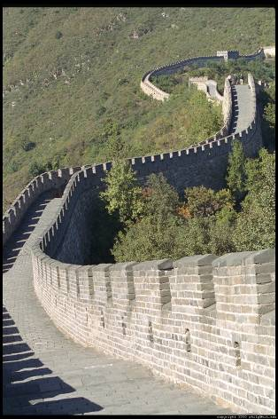
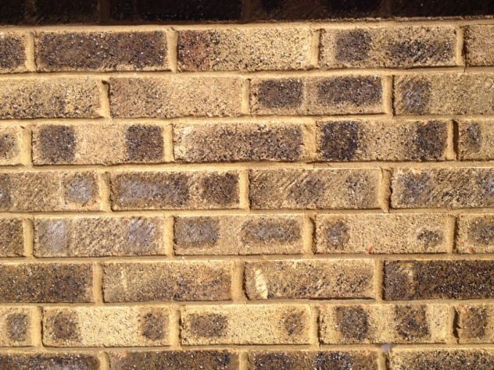
Structural Informatics
Which is the stable wall?
Great Pyramid
of Giza
c.2560 BC
The CCDC
c.1992
Hadrian’s Wall
c.122
A
B
Great Wall
of China
c.1368
The database of walls
indicates that A is the
frequently observed arrangement and therefore the one that achieves stability.
My House
c.1967

Slide 3
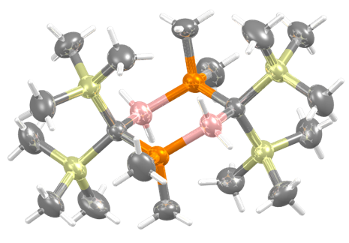
The Cambridge Structural Database (CSD)
>1,206,500
> 1.1 million structures
  >94M 3D coordinates
> 28 million bond lengths
  >2M unique distributions
> 40 million valence angles
  >3M unique distributions
> 14 million torsion angles
  >800K unique distributions
> 2 million rings
  >400K unique distributions
Structures published that year
Structures published previously
CSD Refcode ELOFUJ
The 1.1 millionth CSD structure
A CSD Communication determined by Bill Clegg
The CSD. Acta Cryst. (2016). B72, 171-179

Slide 4
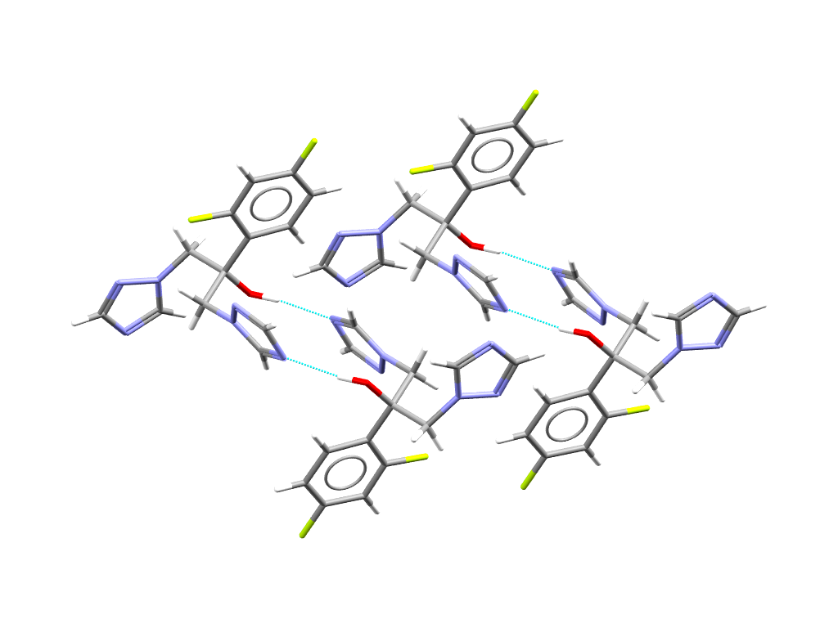
Characteristics that influence stability
Molecular
Conformation
Hydrogen Bond
Donor/Acceptor Pairing
Hydrogen Bond
Geometry, Symmetry
and Motif
‘Non-Hydrogen Bond’
Intermolecular
Interactions

Slide 5
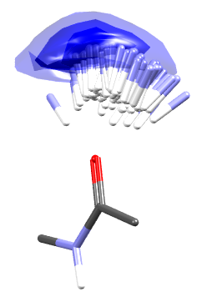
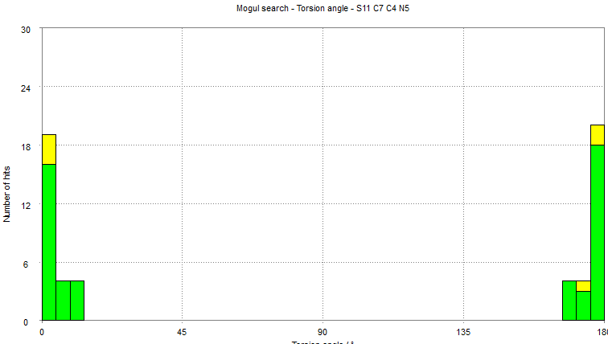
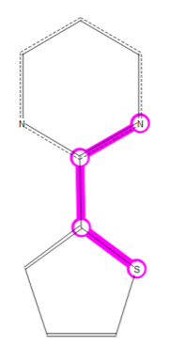
CSD derived knowledge bases
Number
of hits
Tosion angle (º)
Mogul
IsoStar
Molecular geometry distributions
Bond lengths
Valence angles
Torsion angles
Rings
Intermolecular geometry analysis
Interaction distributions displayed as scatterplots or contour surfaces
18,000 pre defined interaction scatter plots
Mogul: I. J. Bruno et al., J. Chem. Inf. Comput. Sci. (2004), 44, 2133-2144
IsoStar: I. J. Bruno et al., J. Comput.-Aided Mol. Des. (1997), 11, 525-537

Slide 6
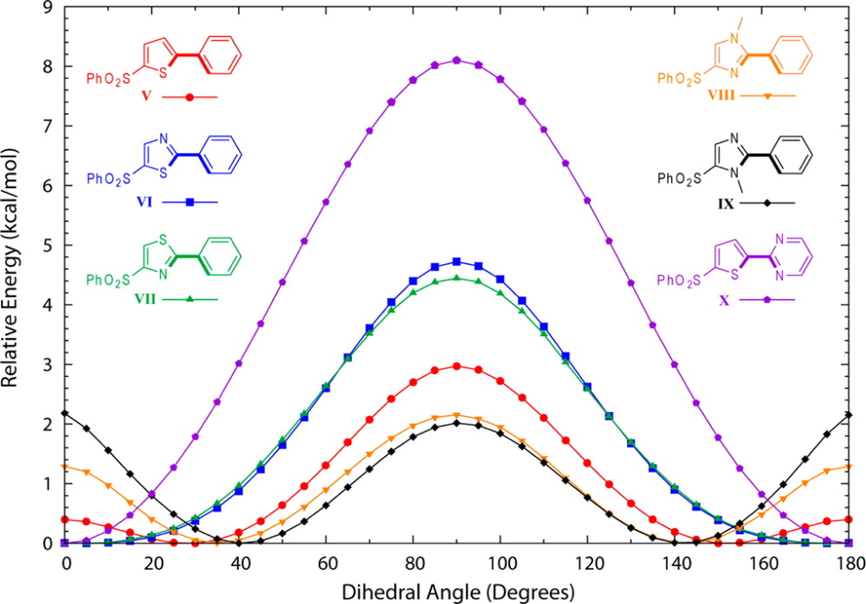
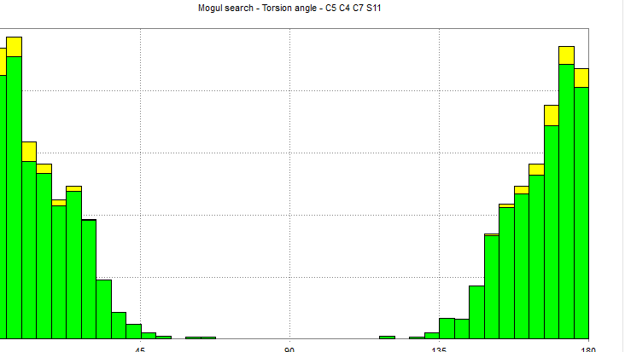
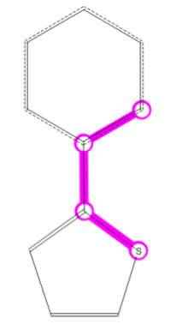
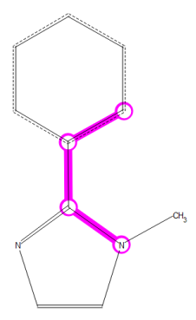
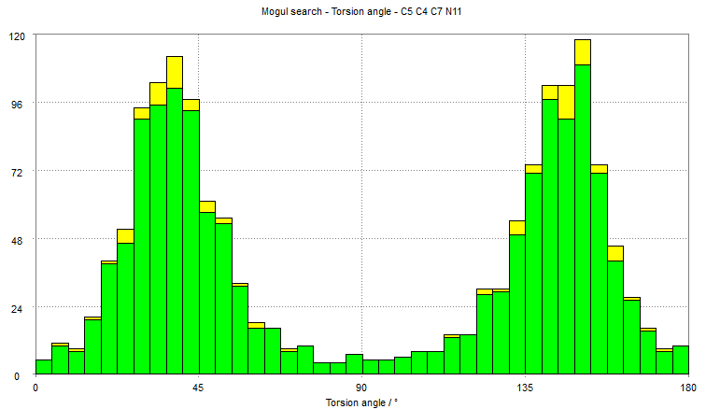
Intramolecular geometries
Computational method: SCRF-B3LYP/6-31G* dihedral scans
Mogul provides histograms in < 10 seconds per torsion angle
N. A. Tamayo et al., J. Med. Chem. (2015), 58, 4462–4482

Slide 7
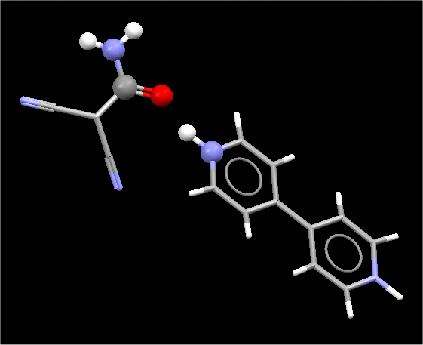
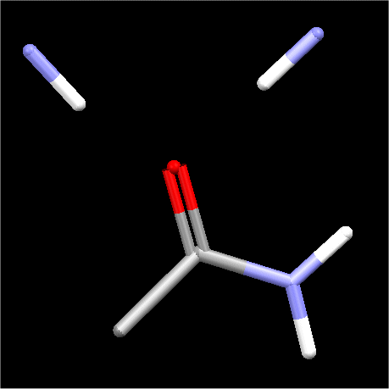
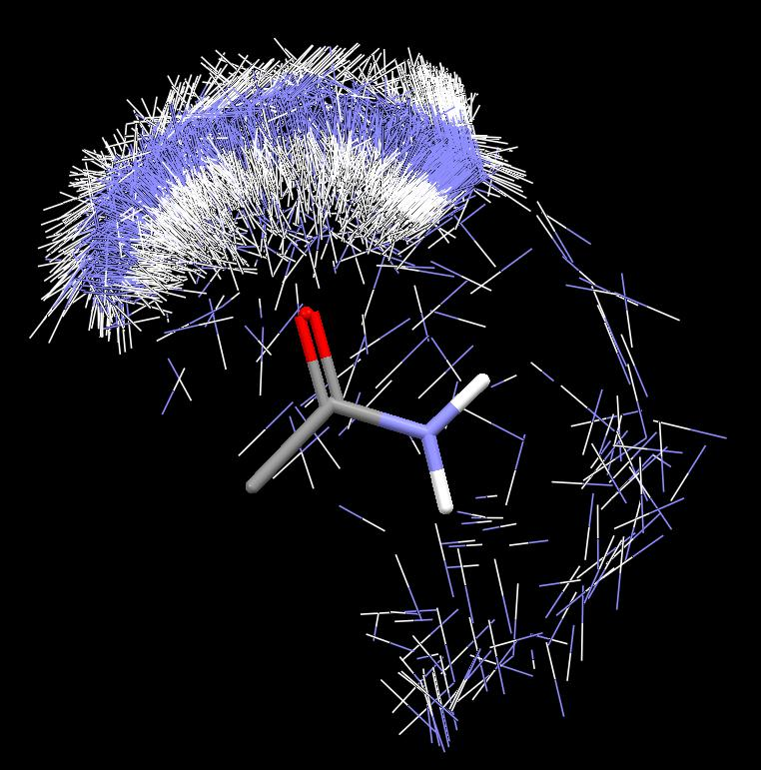
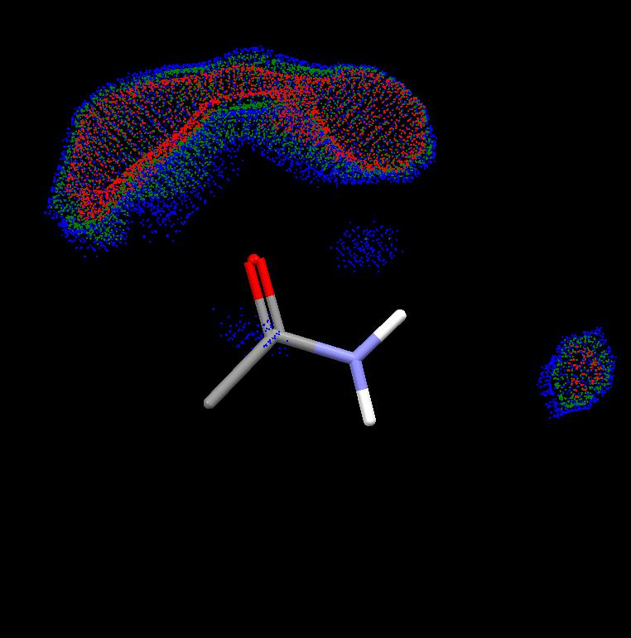
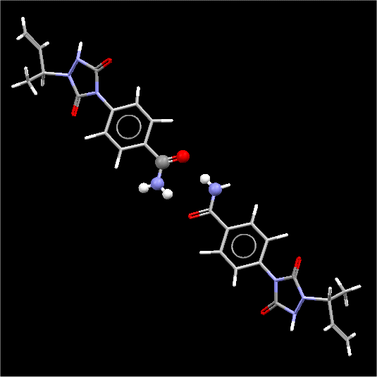
Intermolecular interactions
central group: -CONH₂
contact group: NH
Search for structures containing desired contact
Superimpose hits and display as scatterplots or contour plots

Slide 8
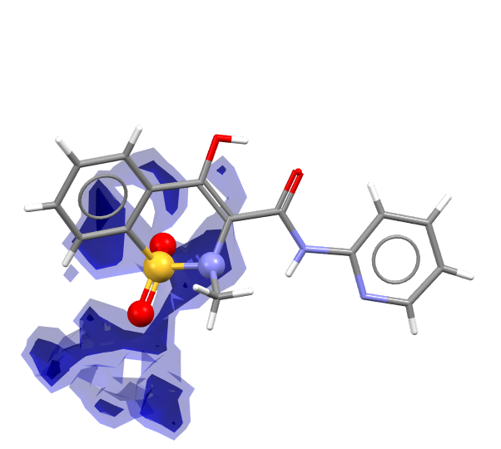
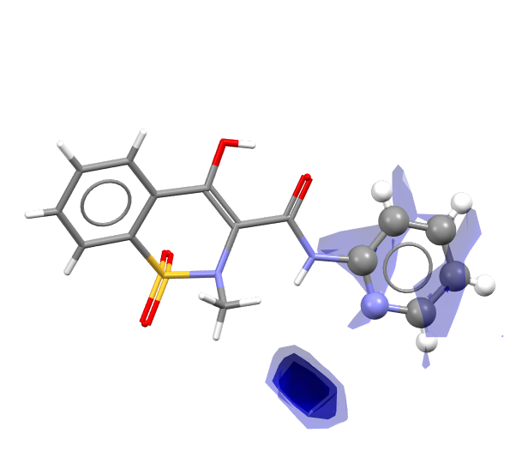
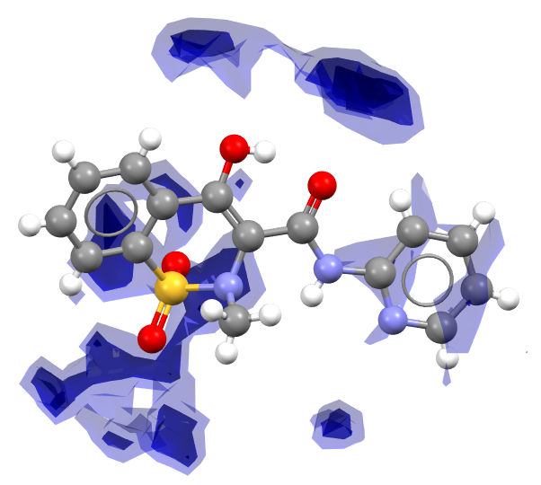
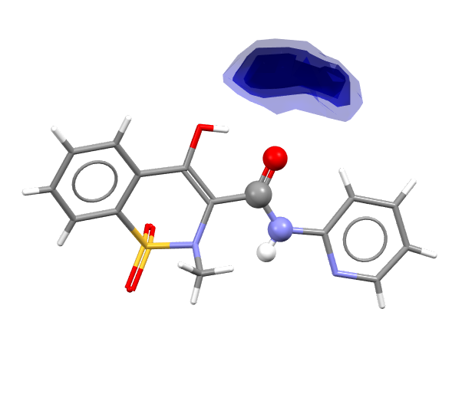
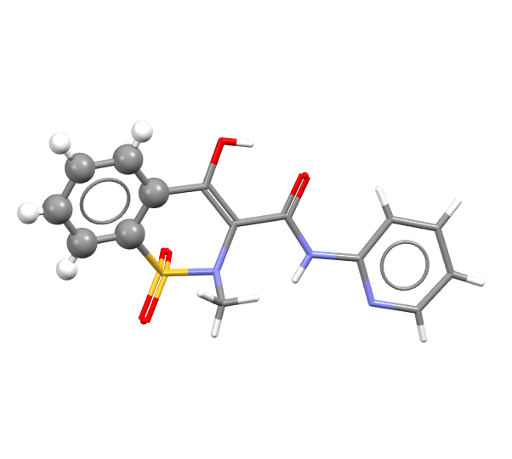
Combining plots into Full Interaction Maps
Molecule is broken down into fragments
IsoStar maps for each fragment are combined to give the Full Interaction Map
Multiple maps can be generated for different probes
P. A. Wood et al., CrystEngComm (2013), 15, 65–72

Slide 9
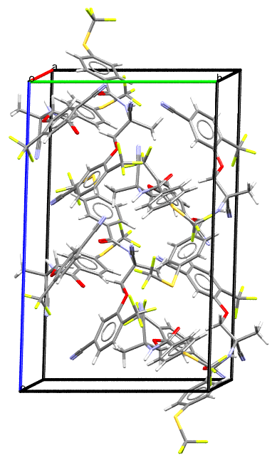
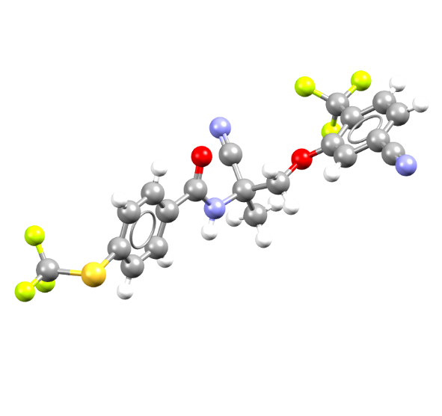
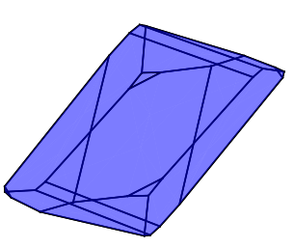
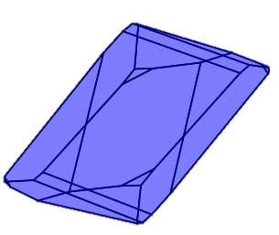
Where do our workflows fit?
Molecule
Form
Particle
Properties
Solid Form Informatics
Particle Informatics

Slide 10
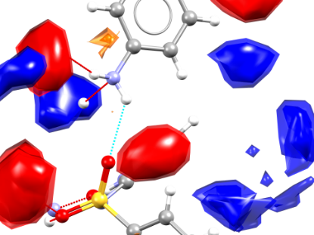
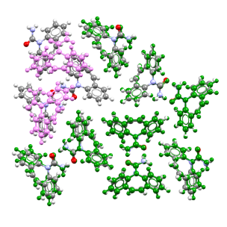
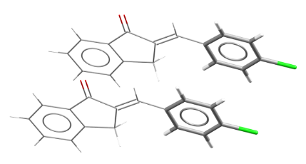
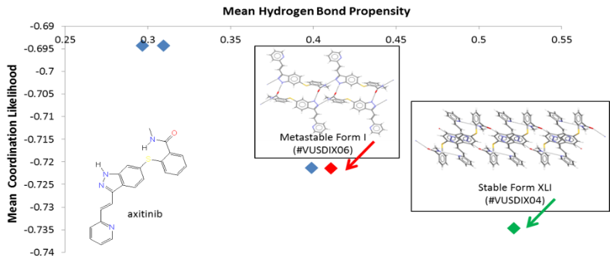
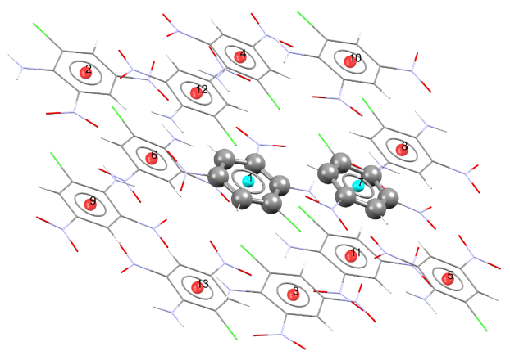
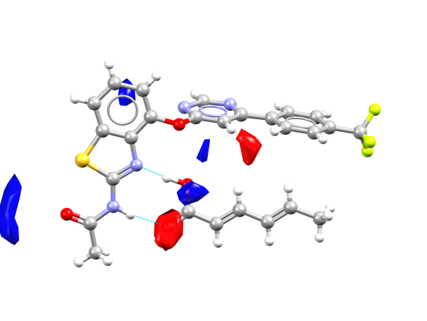
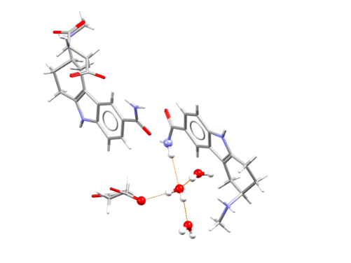
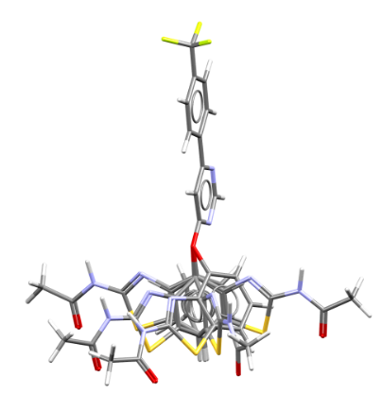
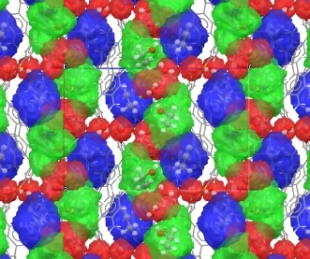
CSD-Materials
Crystal Packing
Similarity
Full Interaction Maps
Motif Search &
Packing Feature Search
Solid Form Assessment
Solid Form Investigation
Solid Form Prediction
Hydrogen Bond
Propensity
Aromatics Analyser
Conformer
Generator
Molecular
Complementarity
Hydrate Analyser &
Solvate Analyser

Slide 11
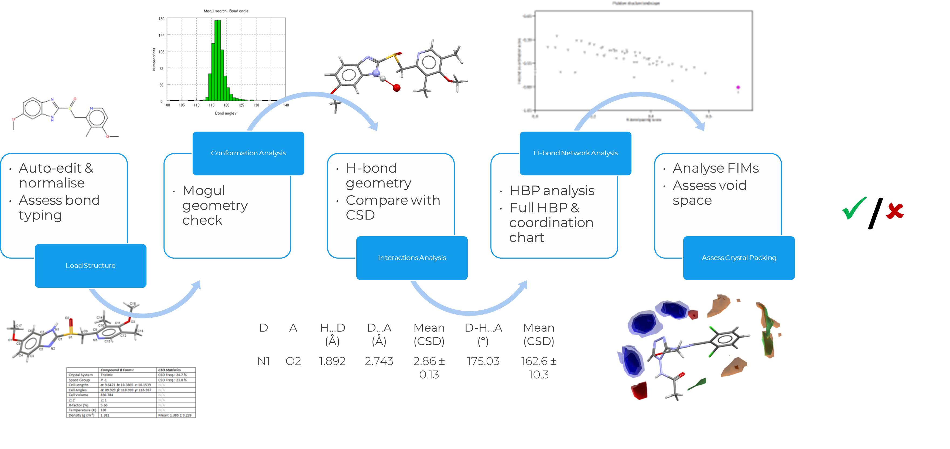
The “Health Check” methodology
N. Feeder et al., J. Pharm. Pharmacol. (2015), 67(6), 857-868

Slide 12
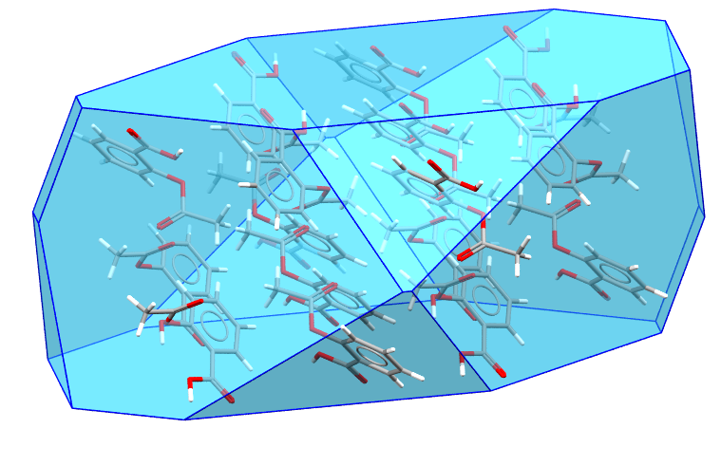
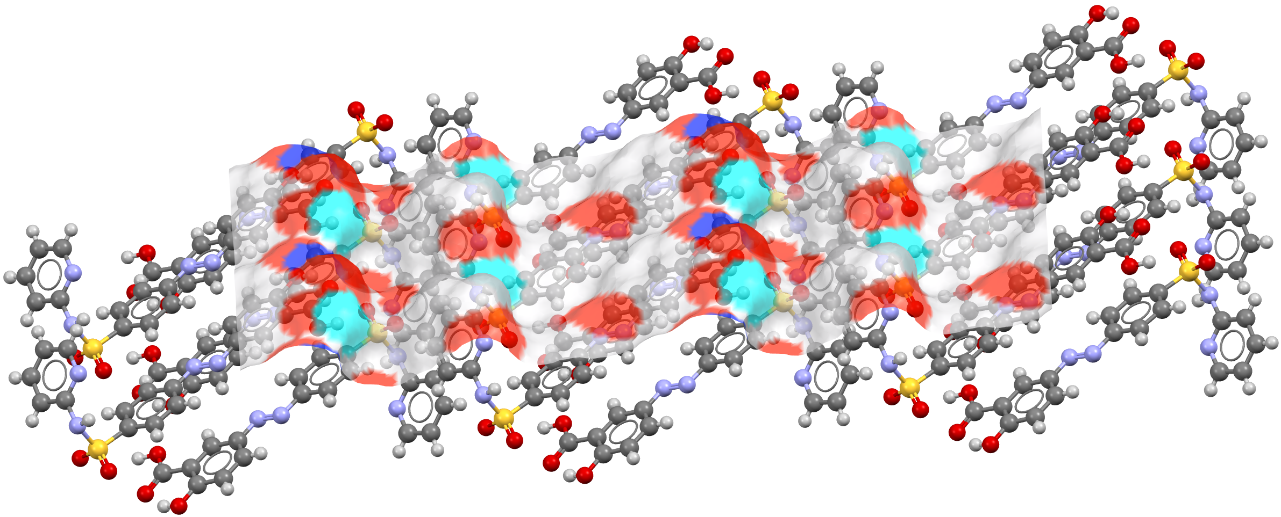
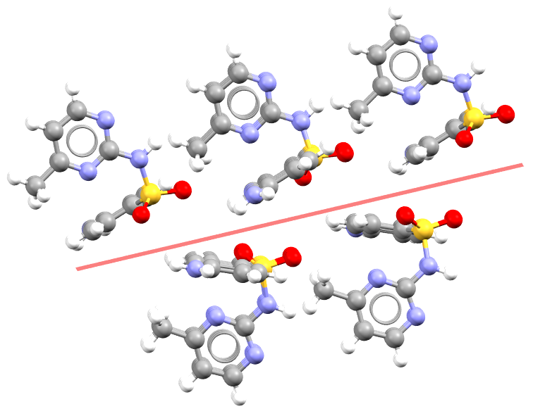
CSD-Particle
Morphology calculations
Visualisation and analysis of surface properties
Identification and analysis of potential slip planes
M. J. Bryant et al., CrystEngComm (2018), 20, 2698-2704
M. J. Bryant et al., Cryst. Growth Des. (2019), 19, 9, 5258-5266

Slide 13
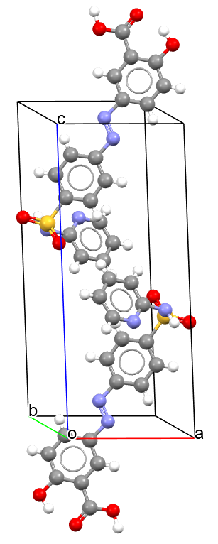
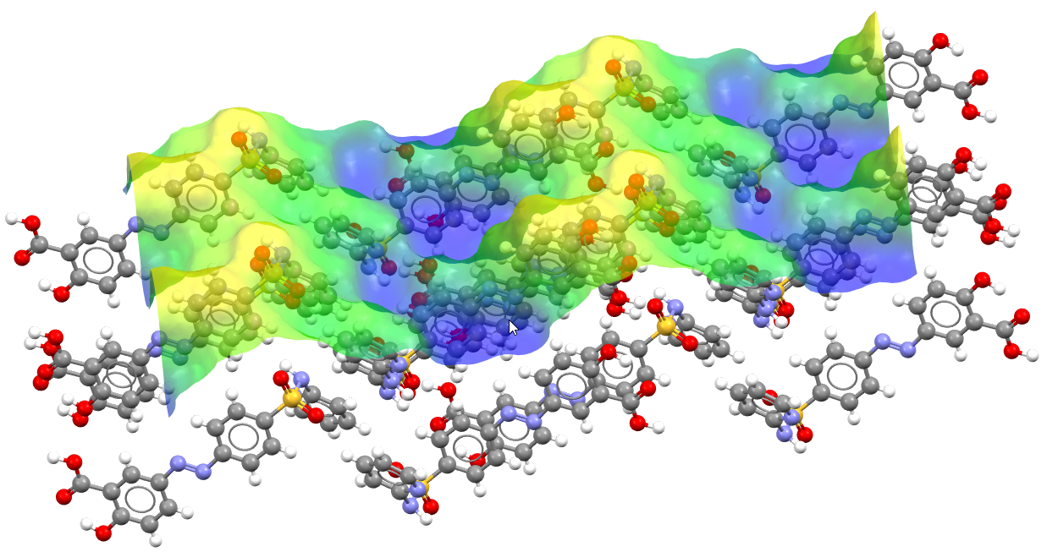
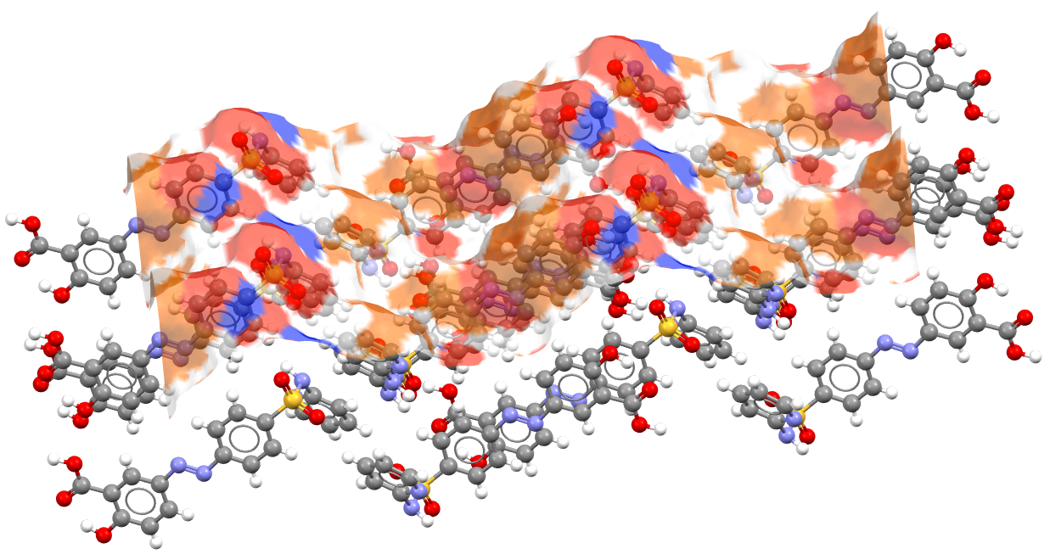
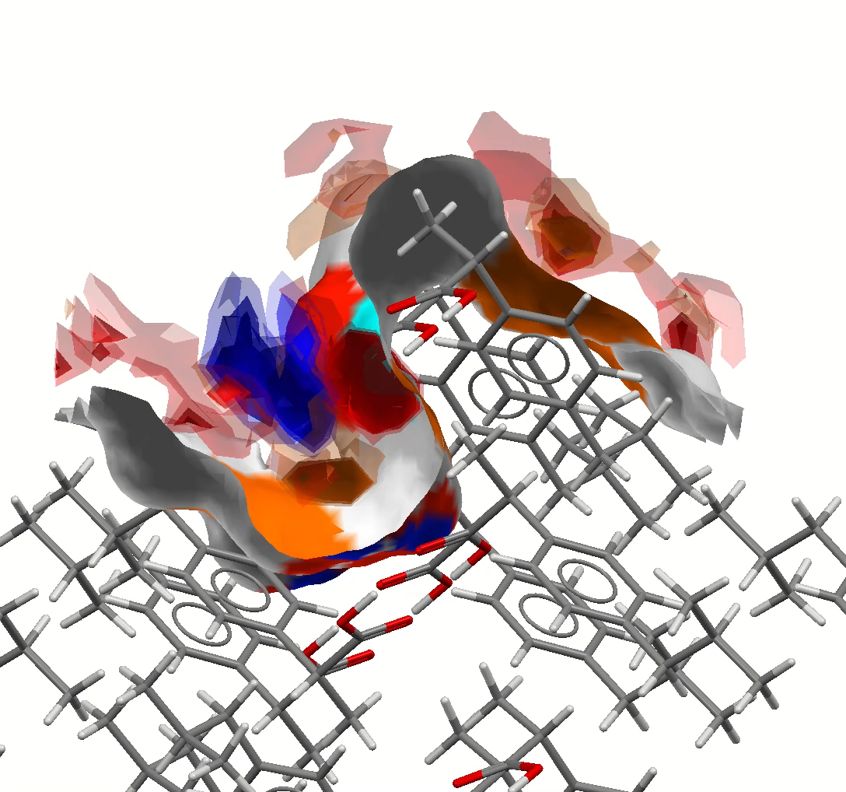

Particle Informatics
Descriptors
Physical | Chemical
Reticular Surface Area | Functional group analysis
Rugosity | Hydrogen bond donor/acceptor density
RMSD, skewness, and kurtosis
Peak Analysis | Aromatic bond density
Statistically derived interaction data

Slide 14
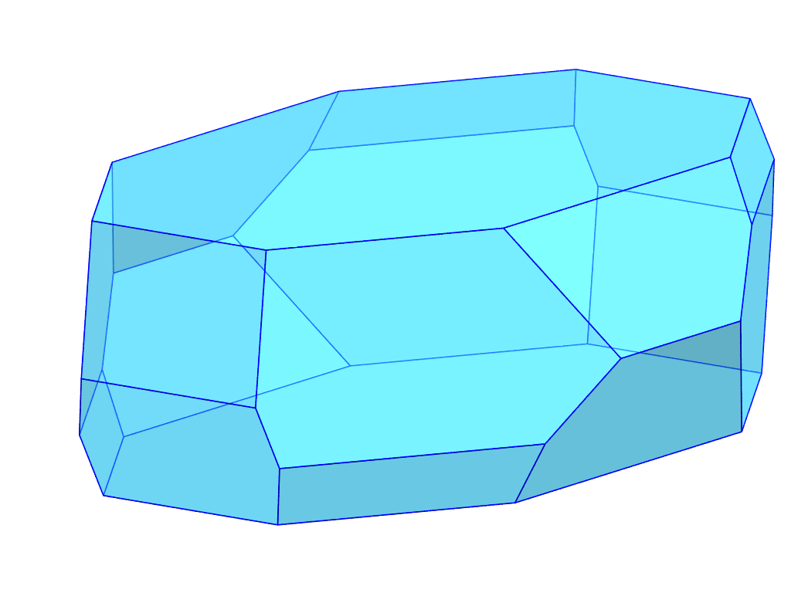


Particle Informatics
Facet
Physical descriptors
Chemical descriptors
Aggregated particle properties
Wettability
Sticking
Compaction
Flow
Facet
Physical descriptors
Chemical descriptors

Slide 15
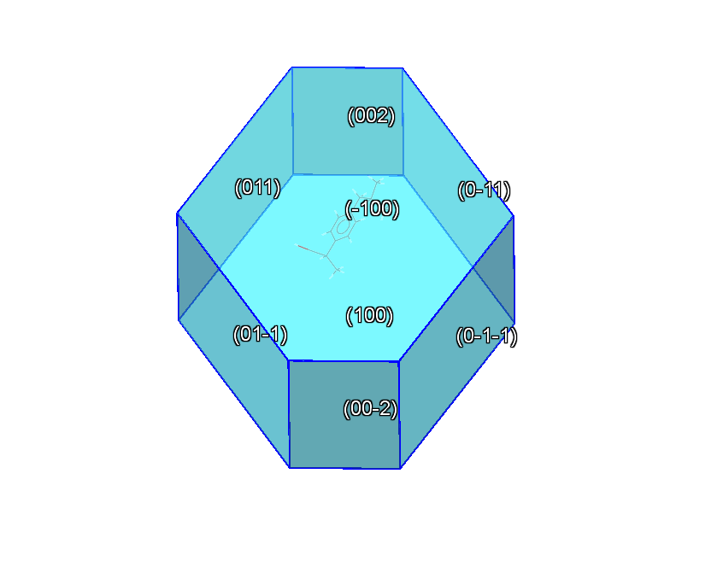
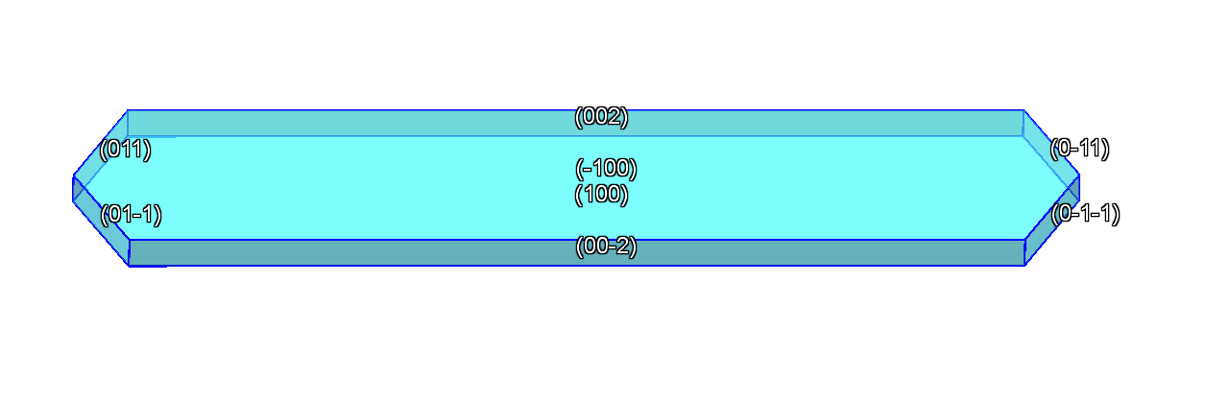
Ibuprofen punch sticking
Ibuprofen forms different morphologies depending on crystallisation solvent
Same facets, different ratios and surface areas
Higher Sticking Propensity
Lower Sticking Propensity
Ethanol
Ethyl Acetate
H. Cano et al., J. Cryst. Growth (2001), 224, 3-4, 335-341

Slide 16




Particle properties
Higher Sticking Propensity
Lower Sticking Propensity
A.A. Moldovan and A.G.P. Maloney, in preparation

Slide 17





The digital future?
Forms needles?
Crystal Structure Predictor
Tablets well?
Sticky?

Slide 18

Morphology landscape
Consider small:medium vs. medium:large ratios of a bounding box
Morphology calculations

Slide 19

Morphology landscape
M. K. Corpinot, L. Iuzzolino, S. L. Price and D.-K. Bučar, unpublished work.

Slide 20


Morphology landscape
S. Kumar et al., Pharmazie (2008), 63, 136 - 143
M. K. Corpinot, L. Iuzzolino, S. L. Price and D.-K. Bučar, unpublished work.

Slide 21

How early could we go?
Particle Property Landscape
Could we understand process behaviour from a molecular diagram?
How well can we control our landscape?
Stickiness
S:M Ratio
M:L Ratio

Slide 22







Acknowledgements
Solid Form Science and Particle Science teams at CCDC
Members of Crystal Form Consortium, ADDoPT and D-DAP
AMSCI, Innovate UK, Knowledge Transfer Partnerships

