Slide 1
How JMP is enabling the future of process chemistry & technology
Stuart Little
November 2022

Slide 2
Towards Data-Driven Chemistry
How can we move from data towards insight?
The volume of data created by chemistry continues to grow
How can we best utilise the data to drive understanding?
Streamline Data Workflows
Generate Process Improvements
Save Time, Reduce Waste
Focus on Innovation

Slide 3
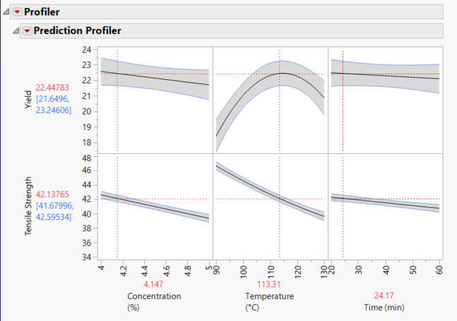
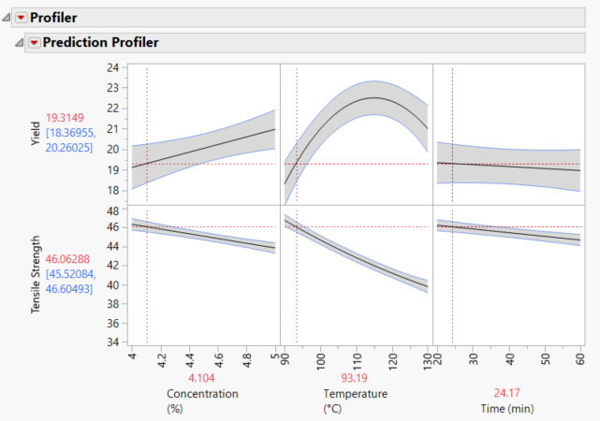
Process Optimisation in JMP
How to optimise a Soda Pulping Process using the tools in JMP
Data for the optimisation generated through DOE
Aim was to optimise Yield and Tensile Strength

Slide 4
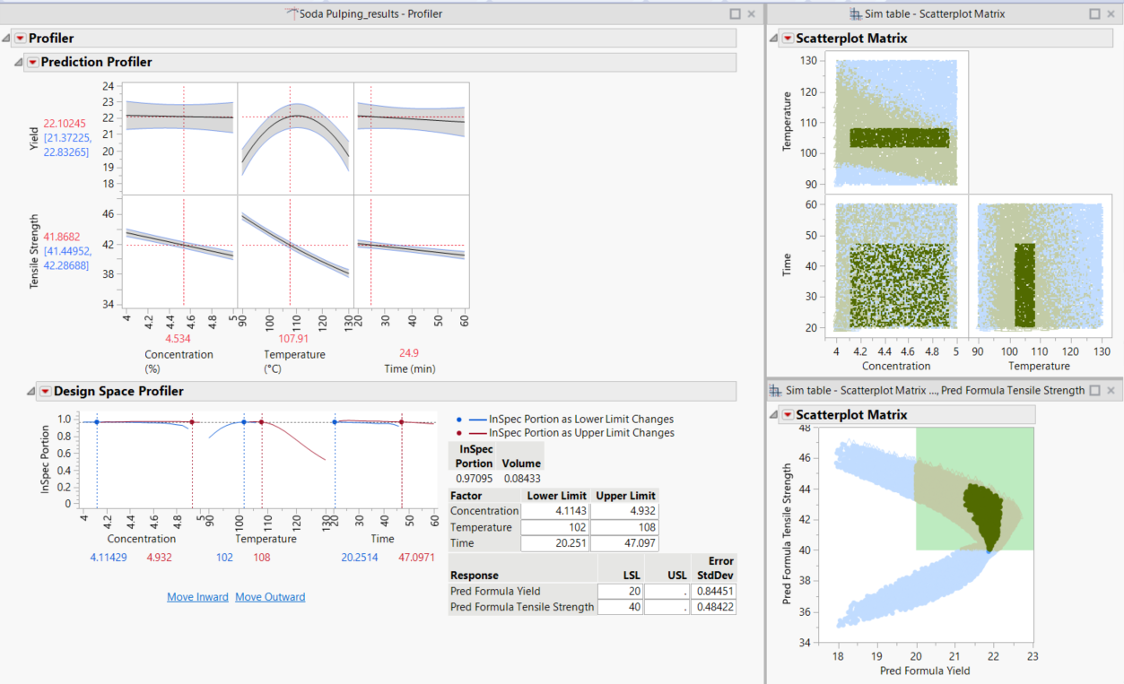
Establishing Robust Specifications
Using the Design Space Profiler in JMP

Slide 5
Where can JMP fit in your work?
DATA
ANALYTIC CAPABILITIES
INSIGHTS
Files
Design of Experiments
Statistical Process Control
Docs
Data Access
Mass Customization
JMP Live
Webpages
Basic Data Analysis and Modeling
Stability and Shelf-Life Analysis
HTML
Data Blending and Cleaning
Content Organization
Databases
Advanced Statistical Modeling
Analytical Methods
Business Docs
Web APIs
Data Exploration and Visualization
Sharing & Communicating Results
Images
Cloud Sources
Predictive Modeling & Machine Learning
Automation & Scripting
3rd Party Files

