Slide 1
Accelerating medicines development through digitalisation
JP Sherlock
Pharmaceutical Technology and Development, AstraZeneca, Macclesfield, UK

Slide 2
1
Changing demands of healthcare
2
From doing digital to being digital
3
Digital platforms for design and development
4
Q&A
Notes:
What do we mean by “digital” in the context of science, engineering, R&D, and manufacturing?
2. What are the relevant digitalization technologies (machine learning, digital twins, artificial intelligence, lab automation, computational modelling, simulation, IoT, industry4.0, lab4.0)?
3. How can these technologies enable better process chemistry and technology?
4. What can we learn from examples outside of process chemistry and technology?
5. What skills will process chemists and technologists need for the digital future?

Slide 3
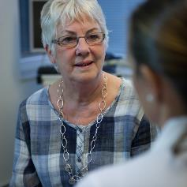
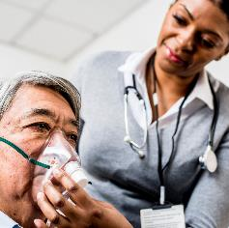
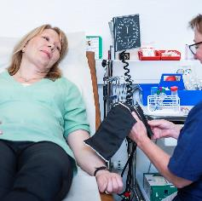
Healthcare in a changing world
Slowing global economic recovery
Growing & ageing populations
Increasing burden of chronic disease
Global growth is expected to slow from 5.5% in 2021 to 4.1% in 2022 and 3.2% in 2023¹
There are now more than one billion people aged 60 and over, most of them in low- and middle income countries²
41 million people die from NCDs each year, 77% of whom are in low- and middle-income countries³
Growing importance of digital in healthcare
Health impact of climate change
Continued impact of COVID-19
Climate change affects many determinants of health - clean air and water, sufficient food, secure shelter⁵
90% of countries reported disruptions to healthcare services one year into the pandemic⁶
Use of tele-health has increased 38 times from pre-COVID-19 levels⁴
Sources: 1 - World Bank | 2 , 3, 5, 6 - WHO | 4 - McKinsey
Notes:
Global trends continue to increase the demand for healthcare and breakthroughs in technology are helping improve health outcomes. The COVID-19 pandemic has highlighted challenges and accelerated healthcare innovation and change.
Slowing global economic recovery
Following a strong rebound in 2021, the global economy is entering a pronounced slowdown amid fresh threats from COVID-19 variants and a rise in inflation, debt, and income inequality that could endanger the recovery in emerging and developing economies. Global growth is expected to decelerate markedly from 5.5% in 2021 as pent-up demand dissipates and as fiscal and monetary support is unwound across the world. This will coincide with a widening divergence in growth rates between advanced economies and emerging and developing economies.
Growing and ageing populations
People worldwide are living longer. By 2030, one in six people will be aged 60 years or over. By 2050, the world’s population of people aged above 60 will double to 2.1 billion. While this shift in distribution towards older ages started in high-income countries, it is now low- and middle-income countries that are experiencing the greatest change. By 2050, two-thirds of the world’s population over 60 years will live in low- and middle-income countries.
Increasing burden of chronic disease
Noncommunicable diseases (NCDs) kill 41 million people each year, equivalent to 71% of all deaths globally. NCDs disproportionately affect people in low- and middle-income countries where more than three quarters of global NCD deaths occur. People of all age groups, regions and countries are affected by NCDs. The risk factors contributing to NCDs include diet, smoking and lack of exercise.
Growing importance of digital in healthcare
Data management in healthcare is moving beyond storing data, to focusing on extracting insights on population health management and value-based care to improve health outcomes and personalised healthcare. Innovations in technology are allowing people to monitor their own health and become active participants in managing their healthcare. For example, Internet of Things (IoT) applications and technologies are influencing patient engagement strategies and improving patient interactions with healthcare systems.
The health impact of climate change
Climate change affects many determinants of health: clean air, safe drinking water, sufficient food and secure shelter. For example, extreme high air temperatures raise the levels of pollutants in the air that exacerbate cardiovascular and respiratory diseases. Increasingly variable rainfall patterns are likely to affect the supply of fresh water. This can compromise hygiene and increase the risk of diarrhoeal disease, which kills over 500,000 children below the age of five every year.
Continued impact of COVID-19
The COVID-19 pandemic has driven changes in health system spending that impact access to medicines. For example, where hospitals beds were scarce, payers reallocated resources and prioritised treatments that could help keep patients out of hospital. The pandemic also demonstrated that when needed, healthcare systems can move quickly to grant rapid access to innovative new medicines such as the COVID-19 vaccines.
Sources:
The World Bank https://www.worldbank.org/en/publication/global-economic-prospects
WHO https://www.who.int/news-room/fact-sheets/detail/ageing-and-health
WHO https://www.who.int/news-room/fact-sheets/detail/noncommunicable-diseases
McKinsey https://www.mckinsey.com/industries/healthcare-systems-and-services/our-insights/telehealth-a-quarter-trillion-dollar-post-covid-19-reality
WHO https://www.who.int/news-room/fact-sheets/detail/climate-change-and-health
WHO https://www.who.int/news/item/23-04-2021-covid-19-continues-to-disrupt-essential-health-services-in-90-of-countries

Slide 4
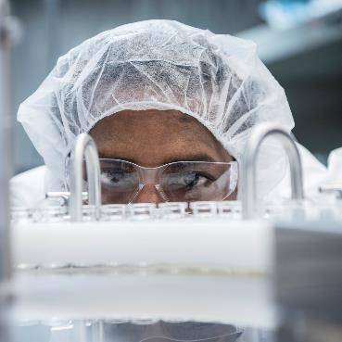
The impact of digital
Patients
Advancing our disease understanding to deliver better medicines and treatments, more quickly, to more patients
Our organisation
Transforming the way we work to accelerate our science, grow our business and empower people, sustainably
The future of medicine and healthcare
Pioneering new modalities, manufacturing and patient experiences to change billions of lives for the better
Notes:
We are on a journey from ‘doing’ digital to ‘being’ digital.
Our vision is of a future of integrated, individualised healthcare solutions, focused on improved patient outcomes, driven by science and digital technologies.
A digital transformation is sweeping across the whole of our organisation globally.
It’s empowering our people and our business commercially and operationally, transforming our science, and accelerating the discovery and development of new therapeutics.
It’s helping enhance our understanding of disease biology. Discover new ways to target the drivers of disease. Better predict clinical success. Pioneer new approaches to engagement in the clinic and beyond.
We have always put patients first and at the heart of what we do. Digital is reinforcing our commitment to a patient-immersed culture in every aspect of our business, from discovery through to treatment and ongoing care.
We’re streamlining clinical trials and making them swifter, more convenient and patient friendly. Building sustainability into our science, practices and processes.
Creating new business models and value strategies. Increasing the use of automation. Improving the speed and quality of manufacturing. The delivery of and access to our medicines. Outcomes and support for patients. Support and value for healthcare systems.
Our belief in people, ideas, science and technology is driving this transformation, enabling us to help shape the future of healthcare, better serve the communities we live and work in, and our wider society.

Slide 5
Global Operations at AstraZeneca plays a critical role in the development, manufacturing, testing and delivery of our medicines around the world.
With the world around us changing rapidly, we are evolving our network, our technology and our capabilities to deliver more medicines, to more patients, more quickly and to build a better, more sustainable future.
Pam Cheng
EVP, GLOBAL OPERATIONS & IT

Slide 6
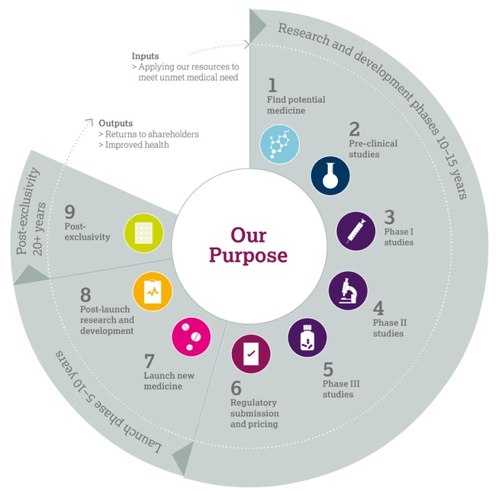
Life-cycle of a medicine
We are one of only a handful of companies to span the entire life-cycle of a medicine from research and development to manufacturing and supply, and the global commercialisation of primary care and speciality care medicines
Notes:
Our business activities span the entire life-cycle of a medicine. As the diagram illustrates, there are eight phases of this life-cycle:
Find potential medicine
Identify unmet medical need aligned with our three therapy areas and undertake scientific research to identify potential new medicines
Initiate process of seeking patent protection
Pre-clinical studies
Conduct laboratory and animal studies to understand if the potential medicine is safe to introduce into humans and in what quantities
Determine likely efficacy, side effect profile and maximum dose estimates
Phase I trials
Begin clinical trials with small groups of healthy human volunteers (small molecules) or patients (biologics) to understand how the potential medicine is absorbed into the body, distributed around it and excreted
Determine approximate dosage and identify side effects
Phase II trials
Conduct trials on small-to-medium sized groups of patients to test effectiveness and tolerability of the medicine and determine optimal dose
Design Phase III trials to generate data needed for regulatory approvals and pricing/reimbursement globally
Phase III trials
Engage in trials in a larger group of patients to gather information about effectiveness and safety of the medicine and evaluate the overall benefits/risk profile
Initiate branding for the new medicine in preparation for its launch
Regulatory submission and pricing
Seek regulatory approvals for manufacturing, marketing and selling the medicine
Submit clinical data to regulatory authorities (and, if requested, generate further data increasingly in real-world settings) to demonstrate the safety and efficacy profiles of the medicine to enable them to decide on whether to grant regulatory approvals
Launch new medicine
Raise awareness of patient benefit and appropriate use, market and sell medicine
Clinicians begin to prescribe medicines and patients begin to benefit
Continuously monitor, record and analyse reported side effects. Review need to update the side effect warnings to ensure that patients’ wellbeing is maintained
Assess real-world effectiveness, and opportunities to support patients and prescribers, to achieve maximum benefit from the medicine
Post-launch research and development
Conduct studies to further understand the benefit/risk profile of the medicine in larger and/or additional patient populations
Life-cycle management activities to broaden understanding of a medicine’s full potential
Consider additional diseases or aspects of disease to be treated or better ways of administering the medicine
Submit data packages with requests for life-cycle management to regulatory authorities for review and approval
Post-exclusivity
Patent expiry and generic entry
Reinvestment of returns

Slide 7
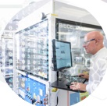
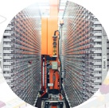
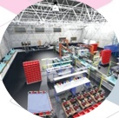
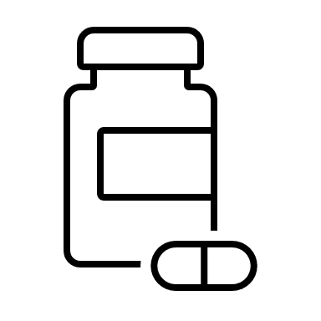
We’re moving from doing digital to being digital
From bench
To patients
DIGITAL
DRUG DEVELOPMENT
DIGITAL
MANUFACTURING
DIGITAL
SUPPLY CHAIN
Accelerating drug development and reducing waste
Using AI to optimise manufacturing processes
Optimising and synchronising end to end supply chains
Notes:
Digital technologies are transforming the way we operate, creating new connections and insights, and accelerating our scientific and commercial processes. Digital is absolutely critical to use achieving our Operations goals.
Our digital transformation is 90% people and 10% technology, and by finding new ways of working and thinking, we are helping to accelerate growth and deliver more medicines to more patients every day.
We are creating a standardised set of digital solutions that connect people, products and processes with technologies, and as you’ll see on this slide, we are investing in three key areas: drug development, manufacturing and supply chain.
Once our digital solutions are scaled across these areas, we will further increase our levels of efficiency and eliminate even more waste from across our supply chain.

Slide 8
Drug development challenges
Acceleration
Experimental Methodology
Skills & capability

Slide 9
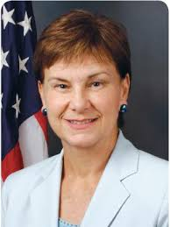
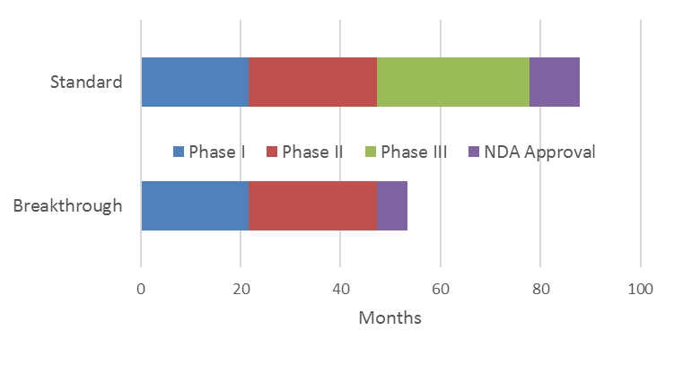
Accelerated clinical programmes
The number and rate of new medicines is increasing
Increased R&D success
Expedited clinical programs
Faster regulatory approval times
… rapid clinical development for breakthrough-therapy drugs will put more pressure on other components of drug development, … development of a final formulation and scale-up of processes will have to occur more rapidly than they traditionally do. It is possible that manufacturing will become the rate-limiting step.
Janet Woodcock (2013, Director, CDER, FDA)
~ 3 yrs

Slide 10
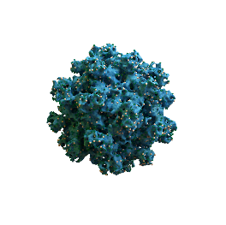
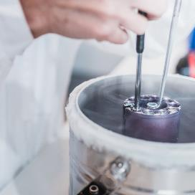
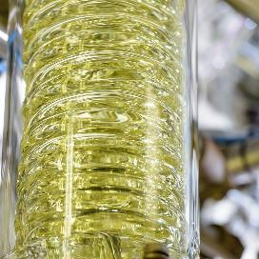
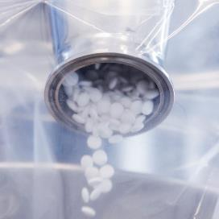
Experimental methodology
As we develop and optimise our synthetic process small changes in physical properties of our API can impact the product manufacturing process
Particles
Mixing
Flow
Compaction
Meaning we may need to refine or even redevelop our process
Notes:
The characteristic of the particle can have an impact on the manufacturing process of the tablets our patients take
The surface properties, size and shape of a particle can impact how it mixes with the other ingredients, how those mixtures flow
.. and the compressibility of that mixture into tablets.
All of this this need to be optimized to ensure the quality attributes of a tablet,
For example, think about the hardness and dissolution of the table, we want tablets to break down in a patient's stomach, not before.
As we optimize the synthetic route to a scaled commercial process small changes to the particle size, shape, or surface morphology it can impact the manufacturing process, we have developed, sometime we have to go back and re-optimize as step
The worst case scenario we may have to go back and develop the whole process again
This can add months or even years onto the development process
Changes on the expectations of drug development timelines in a post covid world mean we want to find new ways of making this process as fast as possible
While continuing to ensure 100% quality in the final tablets we produce

Slide 11
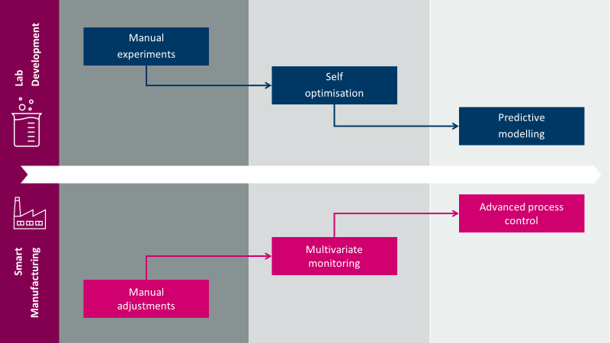
Digital design and make
Integrating people, process, technology and data
Capability (People/process/technology/data)
Digital Maturity
Adaptive
Self-optimizing autonomous processes
Real time control & monitoring
Predictive
Process Digital Twin
Predictive CPV Analytics
Connected
Advanced CPV Analytics
Product Knowledge Management
Digital silos
Process analytical technology

Slide 12
… To Being Digital
Developing solutions through collaboration
CMAC
Supplier relationships
DM²
Collaborative R&D

Slide 13
Digital platforms for accelerated process design
AUTOMATION
Cobots
Data-factories
PREDICTION
Structural informatics
Digital Twin
CONTROL
Data Visualisation
VR/AR
Advanced Process Control

Slide 14
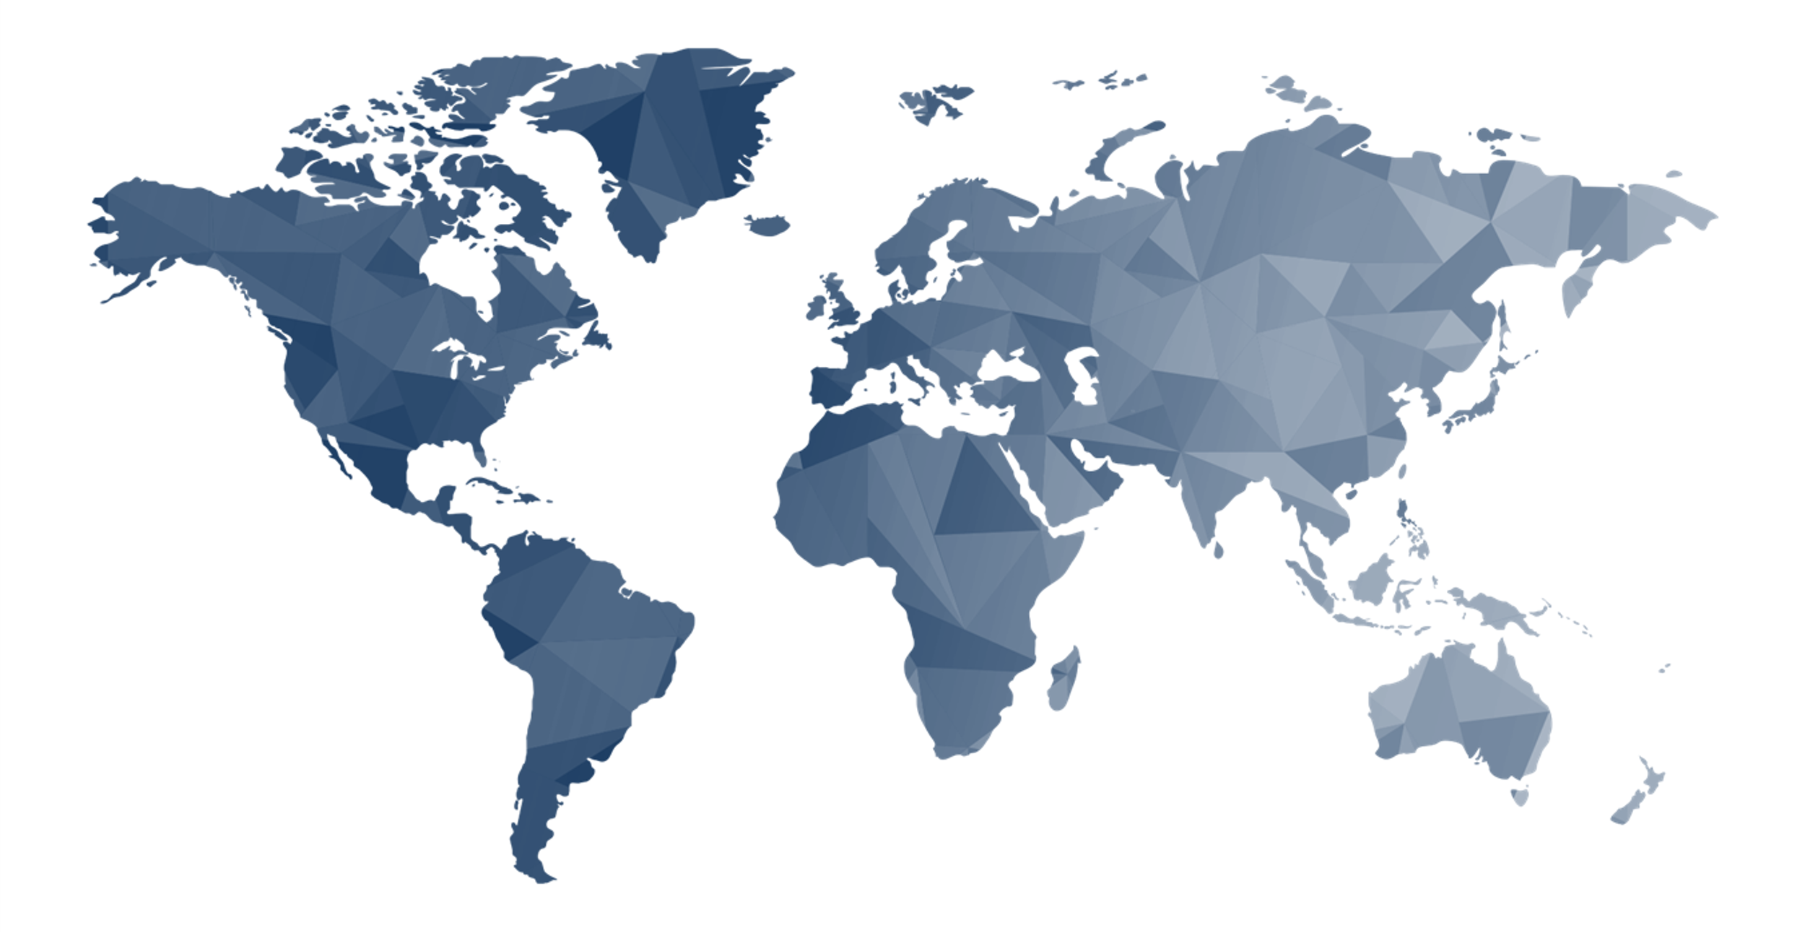
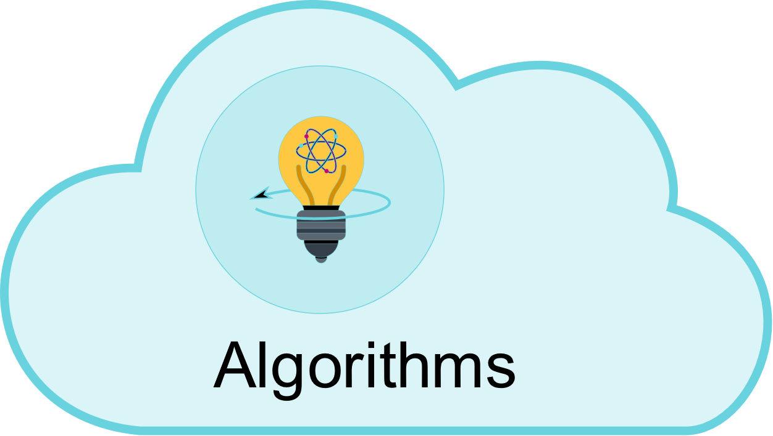
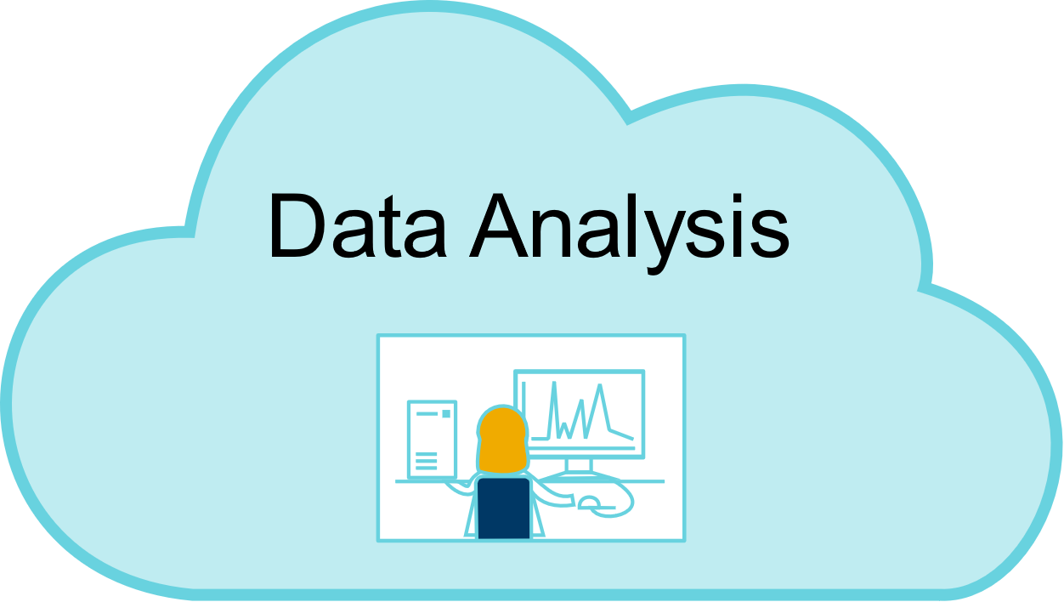
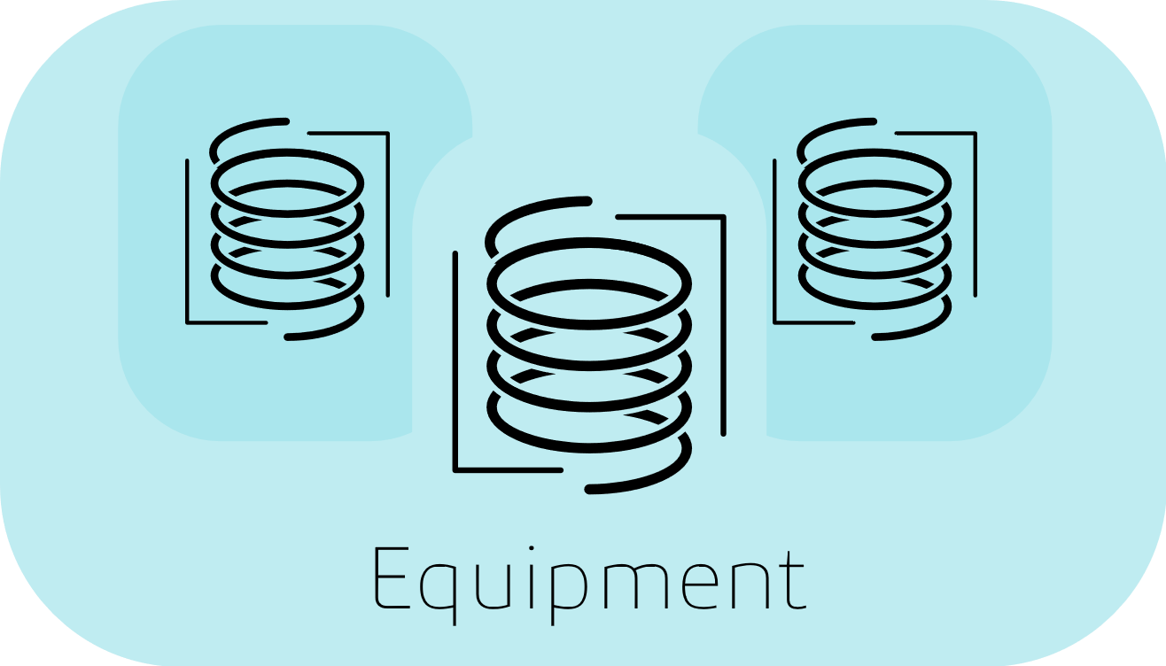
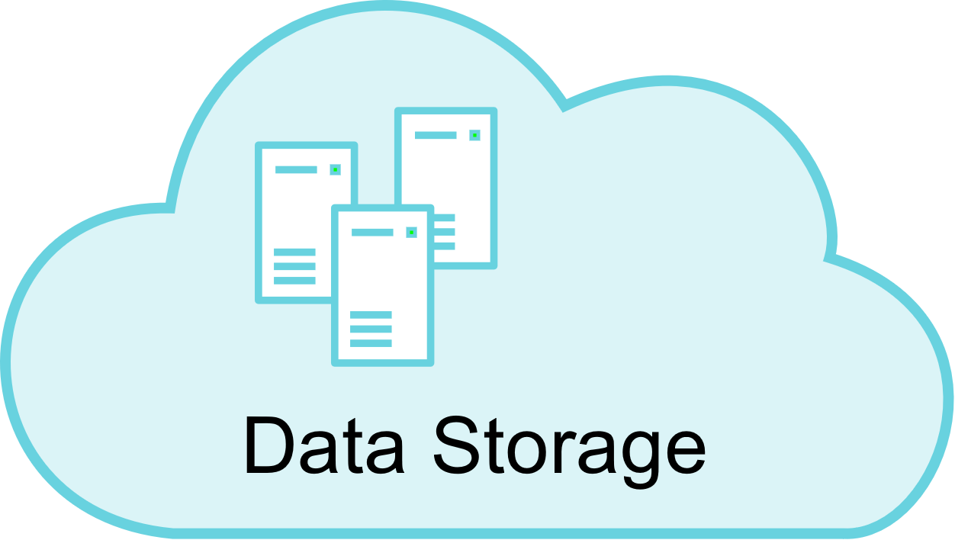
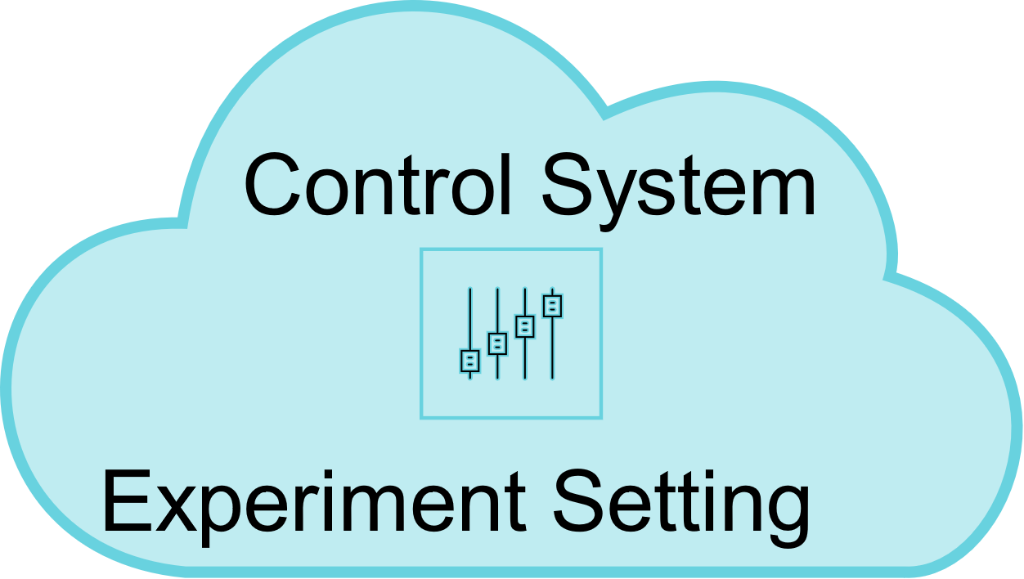
Automation
Maximise our value add through development of digital design
Collaboration with new partners key to accelerate process development and understanding
Internal use only
Notes:
AZ involved in 2.5M Cognitive Chemical Manufacturing EPSRC grant Led by Richard Bourne of Leeds University.
4 year project to demonstrate the use of Machine Learning to Optimise Chemical Manufacturing.
IBM providing AI and machine learning expertise to research grant. In particular, the use of Bayesian optimisation for the self-optimisation of chemical reactions using a small set of data points (efficient process development).
Project to demonstrate the potential of a central cognitive machine learning algorithm based in the cloud for controlling multiple reactor bots for tackling different objectives of a process development problem.
An objective for AZ employees involved this grant is to take the learning and share within AZ and the department to see where the advantages of Bayesian based machine learning can be benefit other areas of the business.
After a recent meeting with IBM recently in the next month we plan on setting up the Bayesian optimisation BOAS IBM service with the AZ self optimising reactor and using on a chemical process.
Collaborating with world leading academic and industrial partners to improve out capabilities in this field to further develop: Understanding of machine learning algorithms
There are many classes of Machine learning algorithm and different goals can be set for experimentation – Process understanding, minimise experimentation, Optimising to get best result. Machine learning techniques have lots of options to choose from when building them. Common to all I think are known as hyper or tuning parameters and these are typically subjectively refined. Some are now trying to build auto tuning methods to make building a model independent of who is building the model. Our internal machine learning experience in CD is limited and learning which machine learning methods and how to teach and apply them to a chemical setting is where our interest are focussed.
How then can be used in driving productivity and process design and optimisation
These methods in combination with flow aim to develop processes at a small scale, gaining process insight, faster, reaching a chosen process quicker, optimised to give the best results, with a greater ability for small scale learning to apply at increased scale, able to react to small changes in input parameters and operating settings to continuously run the process at conditions giving the best output. The benefits can be observed in development through to commercial manufacture.
Software to automate and control flow reactor
Flow needs careful control and monitoring as small changes can impact the process greatly in a beneficial or detrimental way. To Maximise the diverse benefits possible from the workflow the system aims for automation, minimising human intervention to control in real time equipment operations, analytical sampling and analysis as well as statistical analysis to specify the next experimental conditions instructions and initiating the next experiment - as the animation shows.
Process analytical techniques (PAT) for reaction assessment and feedback control
What are the best direct measurements (HPLC) or indirect PAT measurement (IR) and how are they set up to monitor a process, send the information for processing and submit results into the analysis all needs to be defined. We will be looking internally for experts and projects working in this area.
Data handling and storage to enable real time modelling analysis
This is the unfashionable, vital and hidden part of machine learning as data needs to be assembled and stored in real time to act on instantly analyse data to decide instructions for the next experiment. Everyone is interested in analysis output translated into process knowledge and value but this is only possible and fully exploited if the right data is collected, stored, aligned with other data sources to make all data available to analysis techniques.

Slide 15
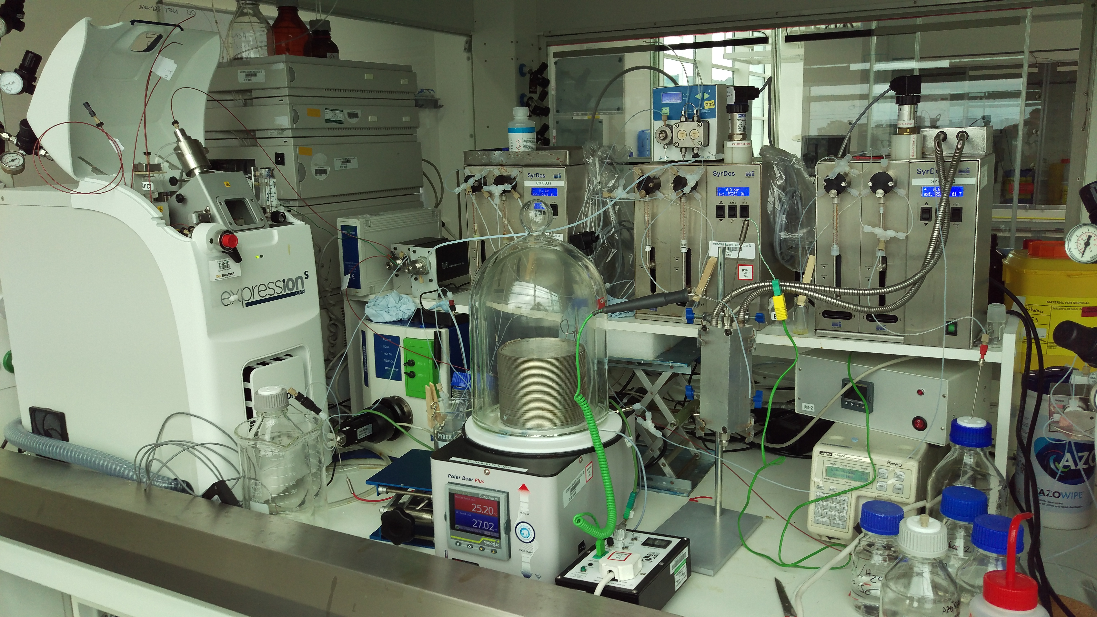
Accelerating Process Design
Faster progress through the development cycle
Keeping Ops off the critical path
Creating time to learn for greater robustness
Self Optimising Flow Reactor
Internal use only
Notes:
Our main collaborator is Dr Richard Bourne of Leeds University who is a world academic leader in using machine learning and automated platforms for developing chemical processes.
Through the success of an early collaboration with AZ Richard was awarded a royal academy of engineering grant.
Grant paid for Richard to spend two days a week at AZ to build a self-optimising reactor for developing pharmaceutical processes at AZ.
AZ automated self-optimising reactor platform is now routinely used on AZ projects in the chemical development portfolio.
We continue to collaborate with Richard through AZ sponsored CASE PhD students researching chemistry applied machine learning for optimisation and understanding
Bespoke software controlling hardware allows reactions and analytical assessment of reaction quality to be performed autonomously
Platform couples analytical data recorded in-line with self-learning algorithms for evolutionary experimentation (next experiment is based on the last) to find optimum reaction process parameters for a given objective(s).

Slide 16
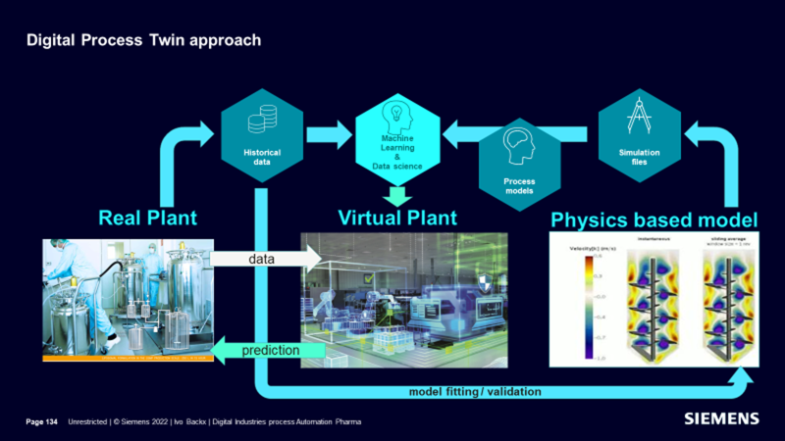
Digital Twins
A digital twin is a virtual model designed to accurately reflect a physical object or process; Simulate and predicts performance of the physical counterpart
Integrated; System of unit operation models and product performance models
Science-based; Physically-based mechanistic models that can provide prediction with limited data

Slide 17
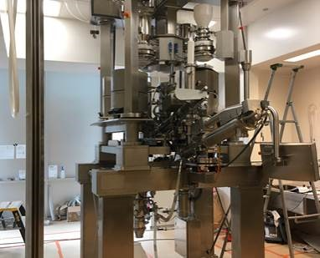
Digital Twin for Continuous Direct Compression
Physical CDC
CDC Digital Twin
Continuous Direct Compression (CDC)
Tablet Manufacturing System
Virtual representation of the physical CDC System -
The CDC Digital Twin

Slide 18
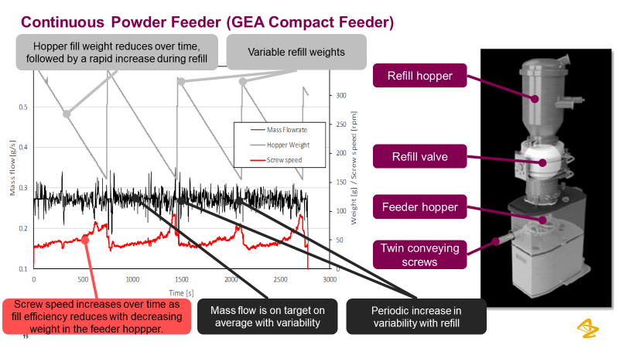
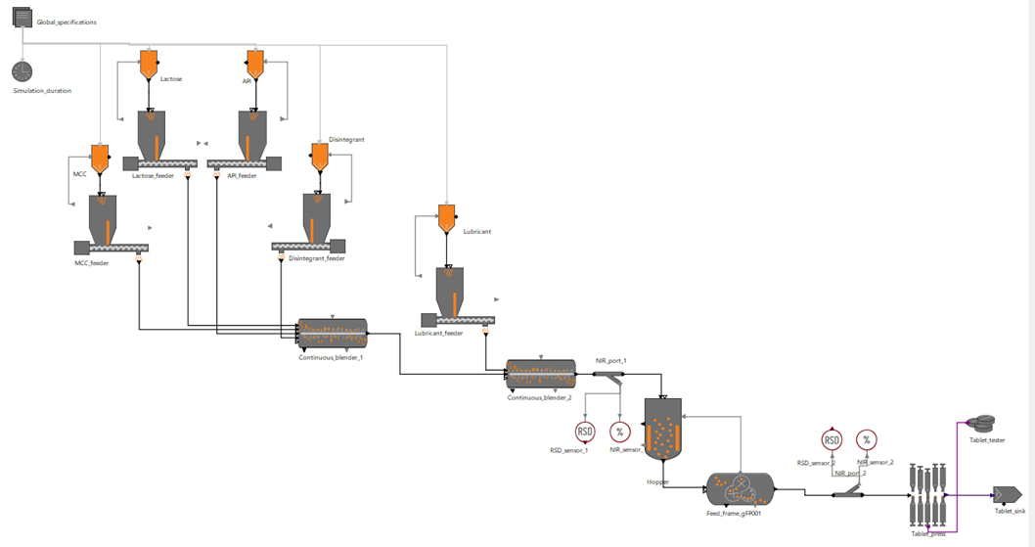
Integrates a dynamic system of individual models
gPROMS provides a robust simulation environment where the individual unit models can be integrated together

Slide 19
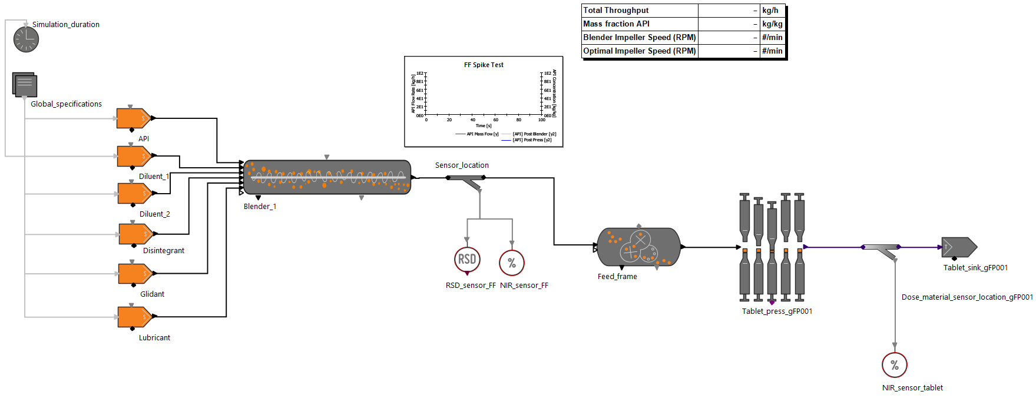
Example use case – Rapid establishment of CDC clinical process
Detailed, particle-based model used to predict effect of material and process parameters and confirm model parameters for the digital twin model
Integrated, digital twin model used to predict full line and product attributes
Process successfully established, resulting in the following savings
12 months lead-time reduction for establishment of CDC
$400k saved on reduced API and reduced technical trials
6 tonnes CO2 eq saved on reduced technical trials

Slide 20
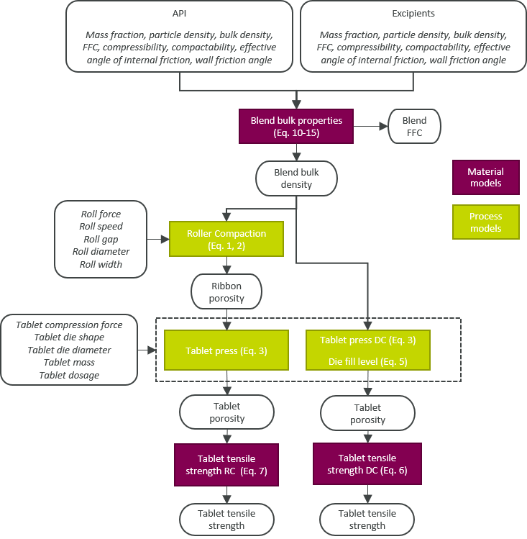
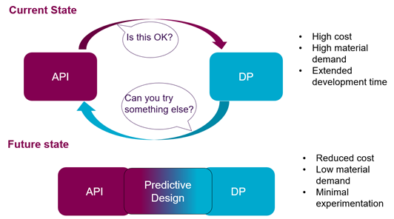
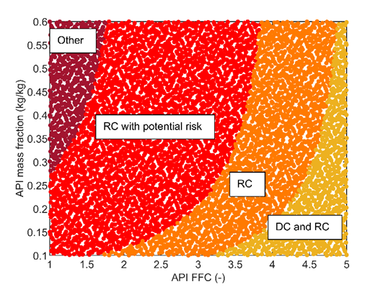
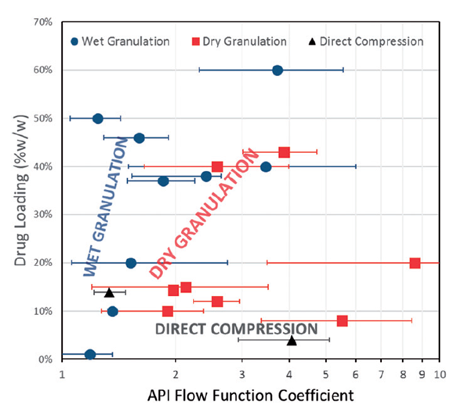
Decision Support Digital Twin
White, L. R., Molloy, M., Shaw, R. J. & Reynolds, G. K. Eur. J. Pharm. Sci. 172 (2022)
Leane et al. Pharm Dev Tech (2018)

Slide 22
Digital Design Acceleration Platform Timeline
Project Start
Team Formed Case Studies defined Workstream planning initiated Timelines and governance group
Training
End Users identified Virtual training developed Benefits clarified Positive feedback received
Validation
Digital tools deployed Case Studies initiated at pharmaceutical partners Feedback gathered from end users
Roadshow
Digital tools demonstrated Case Studies verified Benefits realised and promoted
March 2020
Apr - Dec 2020
Feb - Mar 2021
Jan - Oct 2021
October 2021
August 2022
October
2022
Design & Define
Workstreams defined Working groups formed User Requirements gathered Digital Tools initiated
Develop
Digital Tools developed Risk highlighted and mitigated User requirements prioritised
Feedback
Feedback collated through VoC Continuous improvements to digital tools Latest version deployed
Academic Partners
Subject Matter Experts
Pharmaceutical Companies
Notes:
Pick out a few highlights –
Virtual training due to covid – increased benefits as 3 x more people trained
Working groups contain both developers and end users – co development and co creation of digital tools with continious feedback process
Many tools are now deployed for use and we are using them in the pharmaceutical companies by trying them in real life situations
Roadshow to demonstrate the tools and how they will bring benefits to the industry
Partners - Academic partners gather the data and support the SMEs who are building the digital tools
Pharma companies (end users) who feed in the requirements through case studies and verify the digital tools produced during the collabertaion

Slide 23
Now imagine we could use a virtual environment to develop our products and processes
Use data to predict the optimum manufacturing route
Simulate changes through digital technologies
Develop the best process from the start
Ensure 100% quality every time
Build in operational excellence through robust manufacturing
Do it once, do it right, reduce waste
Delivering high quality medicines to patients faster
Notes:
This way we can build in operational excellence right from the start of development and ensure every tablet is manufactured with 100% quality every time
In development we end up having the throw away the majority of the material we make as we are optimising our processes.
If we can move this development to a virtual environment we can optimise our process in the digital space and only more to a physical space to validate the outcome.
This allows us to drive innovation as it is much easier and faster to try out new things.
This also reduces the amount of laboratory waste we produce which make us more sustainable

Slide 24
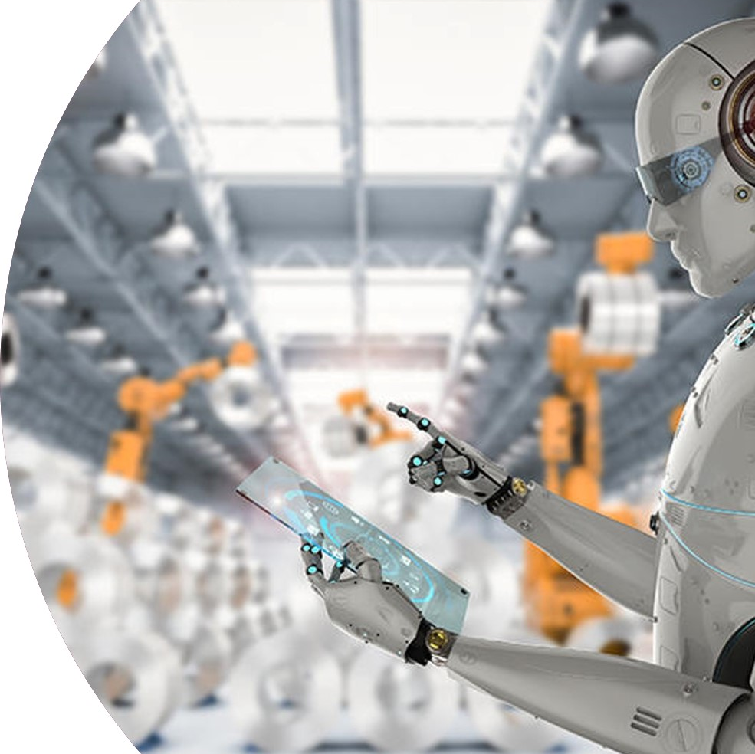
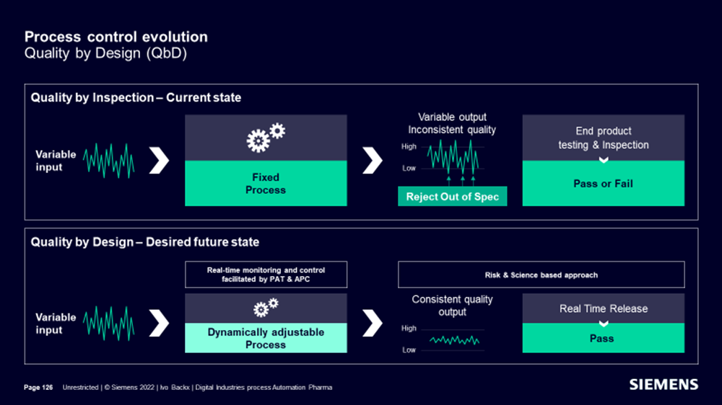
Advanced Process Control
A Golden Virtual Operator Optimising Yield and Quality 24/7
Powerful Multivariable Predictive Controller
Artificial Intelligence for Manufacturing Processes
Dynamic Models and Softsensors
Automatic Realtime Process Optimisation
Agility and Flexibility
Support new Enchanced Control Strategies with PAT integration in the Control Loop
RTD Modeling and Efficient Diversion

Slide 25
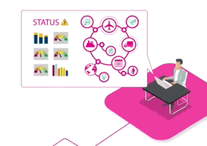
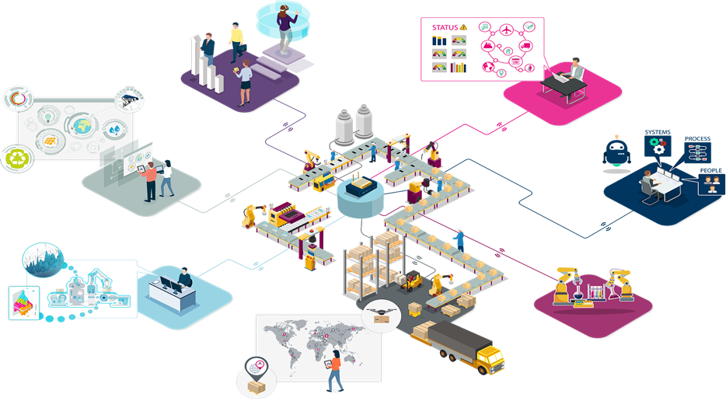
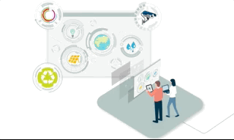
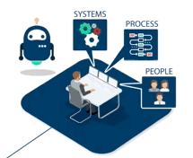
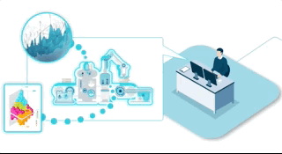
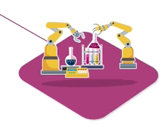
Creating a network of connected smart factories
Immersive Experiences
Augmented and Virtual Reality…
…to reduce training lead-time, increase collaboration and improve safety and efficiency.
Factory Dashboards
Analytics and Visualisations…
..to empower our people to make rapid patient centric and sustainable decisions based on real-time data
3
4
Digital Paperwork
Digital work instructions and workflow…
…to improve ‘right-first-time’, drive greater efficiency, productivity for our business and our planet
2
5
Advanced and Predictive Business Insights & Optimization
Advanced and Predictive Analytics…
…to drive greater insight, predict outcomes, and optimise our processes.
Factory Flow Simulation
AI to create Digital Twins that optimise flow through operations…
…to deliver reduced lead time and increased productivity
6
1
Digital Drug Development
In-silico Experimentation, Digital Twin Modelling and Simulation…
…to accelerate development lead times and reduce waste to benefit our business, patients and planet
7
Digital Supply Chain
Connecting the end-to-end supply chain for enhanced visibility, forecasting and planning…
…to distribute medicines to patients with greater speed and agility and reduced inventory

Slide 26
Summary & Conclusions
Healthcare is changing and the demand for accelerated medicines development is increasing.
Digital has the potential to enable accelerated medicines development AND provide deeper process understanding to add value over the lifecycle.
Automation, prediction and control are the major platforms
Roadmap involves moving from digital silos to being connected, predictive and adaptive
Pre-competitive collaboration provide access to capability and skills
Notes:
Automated datafactories will transform experimentation
Prediction and digital twins will enable virtual experimentation and provide a basis for advanced process control
Advanced process control will enhance medicines manufacturing and support smart factory operations

Slide 27
Acknowledgements
Modelling and Simulation Team
Luis Martin de Juan
Matthew Molloy
Leah White
Astrid Boje
Mariagrazia Marucci
Continuous Manufacturing Centre of Excellence
Felix Farias
Melanie Dumarey
Kristina Roos-Rydell
Chemical Development
Anna Jawor-Baczynska
Oliver Watson
Amy Robertson
Graeme Clemens
Innovation Strategies & External Liaison
Terry Reed
Staffan Folestad
Jonas Johansson
Anders Wellin
Siemens Process Systems Engineering
Dana Barrasso
Xin Li
Renato Wong
Jianfeng Li
Guillermo Jimeno
Caleb Murray
Ben Williams
Sean Bermingham
DDAP Collaboration
Sophie Bailes
CMAC / DM²
Prof Alastair Florence
Prof Blair Johnstone
University of Leeds
Richard Bourne
Adam Clayton
Christopher Horbaczewskyj
Connor Taylor

